Slide 1
Team Apple CDR Presentation
Kaeo, Tryston, Tyrin

Slide 2
Overview of Presentation
Block Diagram
Schematic
Power Budget & Bill of Material
Progress Since PDR
Problems and Issues
Work to be Completed
Questions

Slide 3
Block Diagram

Slide 4
Block Diagram

Slide 5
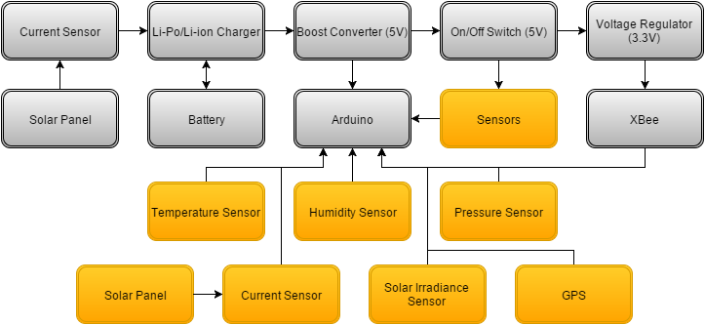
Block Diagram

Slide 6
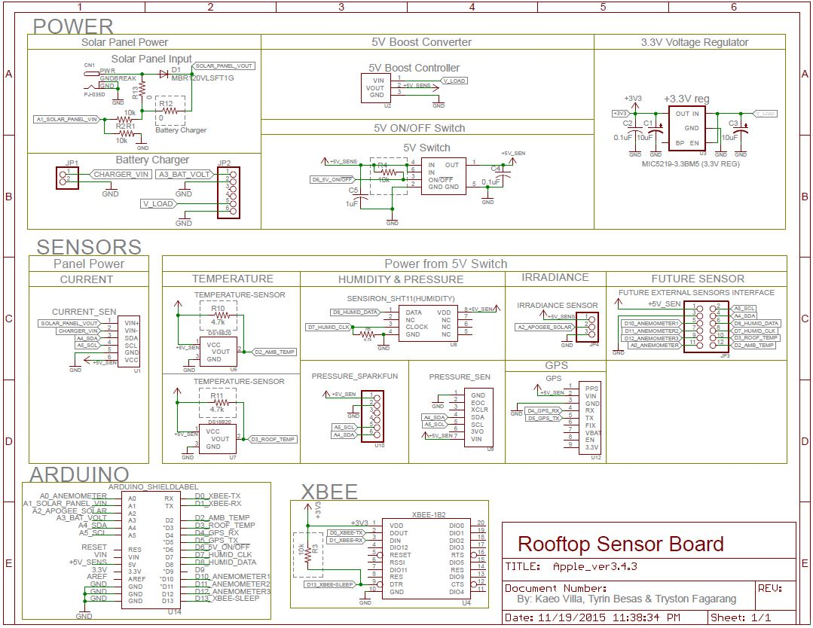
Schematic

Slide 7
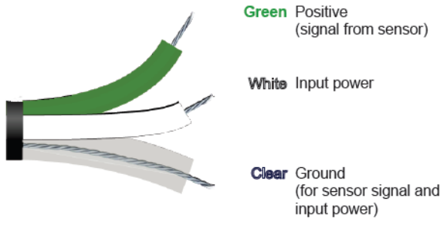
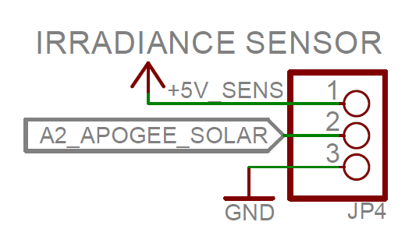
Major Schematic Changes
Changed Irradiance Sensor - Apogee SP-215
No op-amp needed
Not self powered
White
Green
Clear

Slide 8
Power Budget
Major Parts
Part Name | Min Voltage (V) | Supply Voltage (V) | Idle Current (mA) | Typical Current (mA) | Max Current Draw (mA) | Max Power Dissipated (W)
Arduino Uno R3 | 5 | 5 | 0.0001 | - | 50 | 0.25
DC Current Sensor | 3 | 5 | 0.006 | 0.7 | 1 | 0.005
GPS Sensor | 3 | 5 | 4 | 12 | 20 | 0.1
Humidity/Temperature Sensor (Ambient) | 2.4 | 5 | 0.0003 | 0.028 | 1 | 0.005
Pressure Sensor | 1.8 | 5 | 0.001 | 0.65 | 1 | 0.005
Temperature Sensor (Roof) | 3 | 5 | 0.75 | 1 | 1.5 | 0.0075
Solar Irradiance Sensor | 5 | 5 | - | - | 0.3 | 0.0015
Digi International XBee Pro S2B | 2.7 | 3.3 | 15 | 0.0035 | 220 | 0.726
Regulated Power Supply
Part Name | Supply Voltage (V) | Max Supply Current (A)
5V Boost Converter | 5 | 200
3.3V Regulator | 3.3 | 500
Battery Supply
Part Name | Supply Voltage (V) | Max Supply Current (A)
Battery | 3.7 | 6.6
Max Power Consumption (mW)
3.3 V Lines | 5 V Lines | Total (3.3+5)V Lines
726 | 374 | 1100
Max Current Draw (mA)
3.3 V Lines | 5 V Lines
220 | 74.8

Slide 9
Bill of Materials
 | Part Name | Vendor | Product ID/# | Unit Cost | Quantity
1 | USB LiPoly/Li-Ion Charger (3.7/4.2V) MCP73871 | Adafruit | 390 | $17.50 | 1
2 | Arduino Uno R3 | Adafruit | 50 | $24.95 | 1
3 | Ultimate GPS Breakout v3 | Adafruit | 746 | $39.95 | 1
4 | Digi International XBee Pro S2B | Adafruit | 967 | $37.95 | 1
5 | Tenergy Li-Ion 18650 3.7V 6600mAh | Adafruit | 353 | $29.50 | 1
6 | Barometric Pressure Sensor BMP180 (newer model) | Adafruit | 1603 | $9.95 | 1
7 | INA219 High SIde DC Current Sensor Breakout 26V ± 3.2A Max | Adafruit | 904 | $9.95 | 1
8 | Interface Cable - RPSMA Female to RPSMA Male (25cm) | Sparkfun | 12860 | $4.95 | 1
9 | Silicon-Cell Pyranometer SP-215 | Apogee | SP-215 | $235.00 | 1
10 | Large 6V 3.4W Solar Panel 3.4 Watt | Adafruit | 500 | $39.00 | 2
11 | AL-100 Solar Sensor Leveling Plate | Apogee | Al-100 | $35.00 | 1
12 | One Wire Digital Temperature Sensor - DS18B20 | Sparkfun | 245 | $4.25 | 1
13 | 2.4GHz Duck Antenna RP-SMA - Large | Sparkfun | 558 | $9.95 | 1
14 | Sensirion Temperature/Humidity Sensor - SHT11 | Adafruit | 246 | $35.00 | 1
 | Unit Sub Cost (Major Parts)
 | $571.90

Slide 10
Progress Since PDR
Housing - Decided on a housing choice (Outdoor Junction Box)
Schematic - Updated the previous design
Documentation - Parsed the previous documentation of Apple

Slide 11
Some Problems and Issues
Housing - Indoor VS outdoor junction boxes
Schematic - Correctly wired schematic and & designing the board layout
Documentation - Locating information within previous design

Slide 12
Work to be Completed
Board - Layout and Fabrication
Housing - Acquire and Assemble
Documentation - Complete and Organize
Post Assembly - Test and Deployment

Slide 13
Any Questions?

