Slide 1
Project Badger
Preliminary Design Review
Kyle Chan
Cyrus Noveloso
Brianne Tengan
Zachary Dorman

Slide 2
Overview
Block Diagram
Dividing Responsibilities
Problems
Progress
Unfinished Tasks

Slide 3
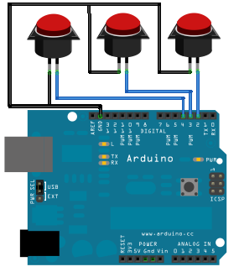
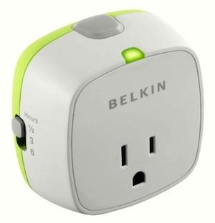
Project Description
Outlet
Power consumption
Measures current
Measures voltage
Toggles access to power
Control
Wirelessly controls the outlet
Uses a button to toggle the outlet

Slide 4
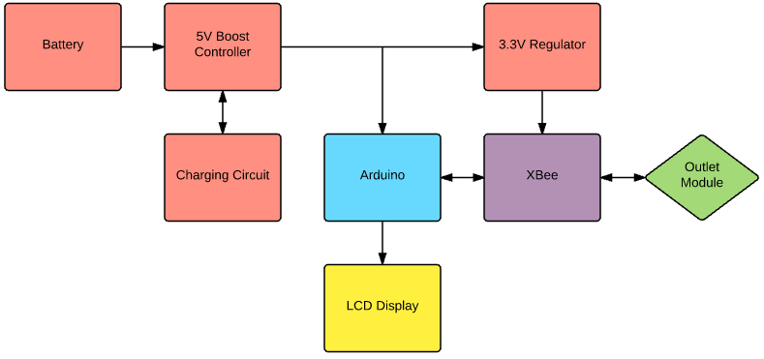
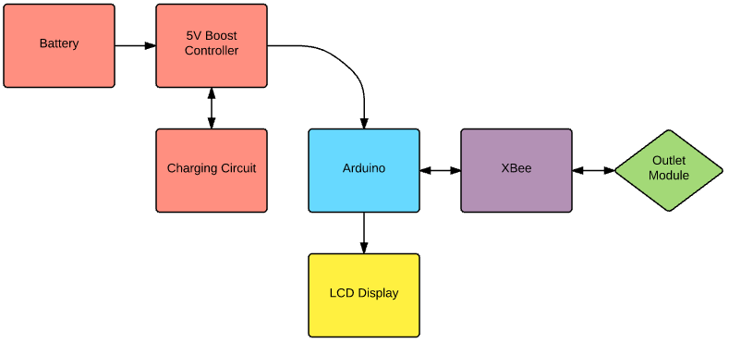
Block Diagram - Control

Slide 5
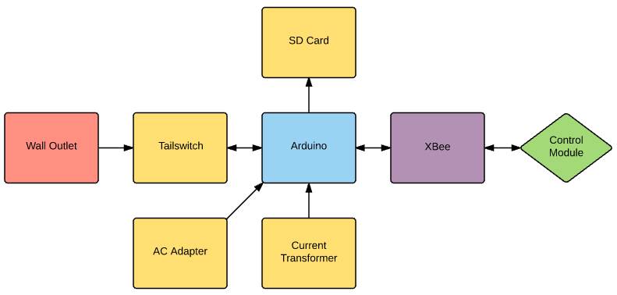
Block Diagram - Outlet

Slide 6
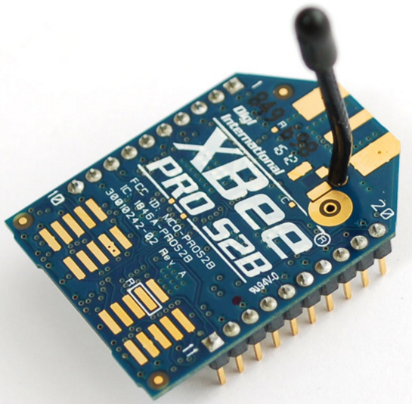
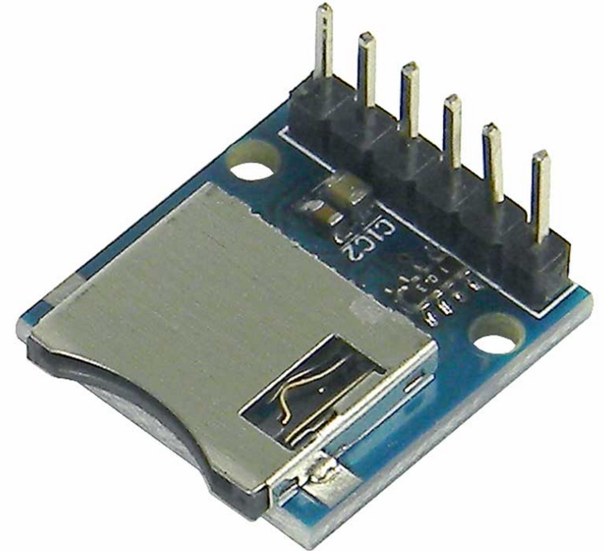
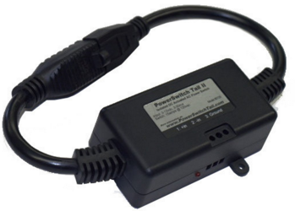
Dividing Responsibilities
Kyle: Control
Xbee
SD Card Reader
LCD
Charging Circuit
Cyrus/Brianne: Outlet
Voltage Sensor
Current Transformer
Powerswitch Tail
Housing

Slide 7
Progress
Modules
Xbee API
Current Sensing
Tutorials
Arduino
Started Eagle

Slide 8
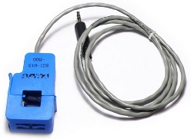
Problems/Issues
Calibrating current sensor
Xbee Documentation

Slide 9
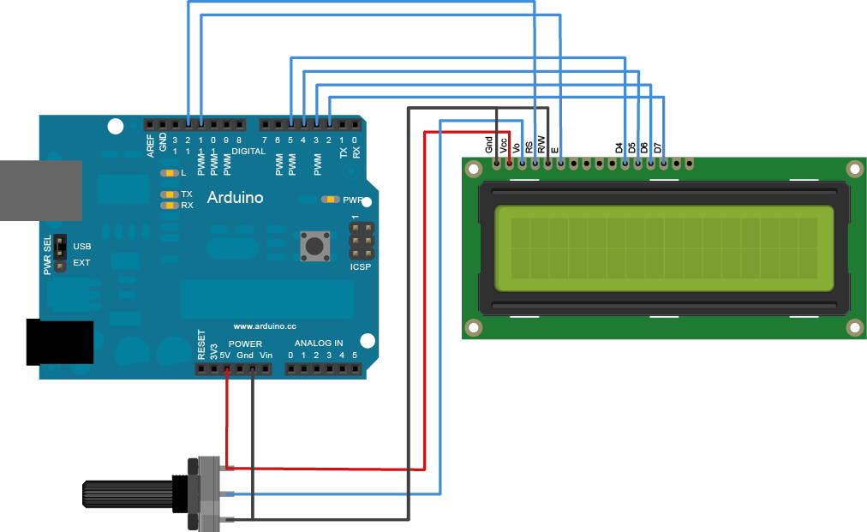
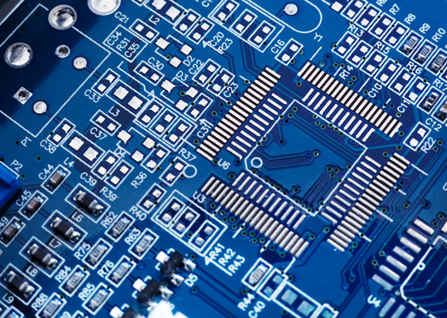
Unfinished Tasks
LCD
Charging Circuit
System Integration
PCB Layout
Create Housing

Slide 10
Thank you
Any questions?

