Slide 1
Team Apple
Preliminary Design Review
Faculty: Dr. Anthony Kuh
Mentor: Tryston Fagarang

Slide 2
Overview
Block Diagrams
Issues / Problems Encountered
Team’s Progress
Next Steps / Gantt Chart

Slide 3
1.
Block Diagrams

Slide 4
In two or three columns
Overall Block Diagram

Slide 5
Signal Block Diagram

Slide 6
You can also split your content
Power Block Diagram

Slide 7
2.
Problems Encountered

Slide 8
In two or three columns
Problems
Cannot upload code to apple board v 3.5.3
Need to find a time to meet with software group working on Apple

Slide 9
3.
Progress Since Proposal Presentations

Slide 10
In two or three columns
Progress
Finished 3D printing the new housing design
Housing ready for deployment once we get the code uploaded
Updated some minor changes to PCB v4.0.0
PCB: Gerber files submitted and ready to be milled

Slide 11
4.
What’s Left?

Slide 12
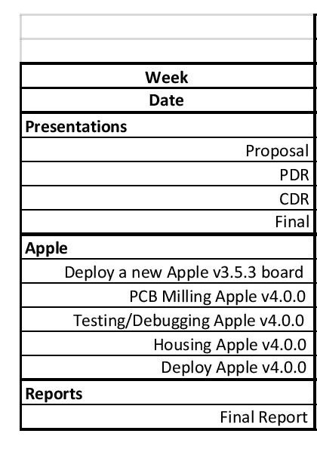
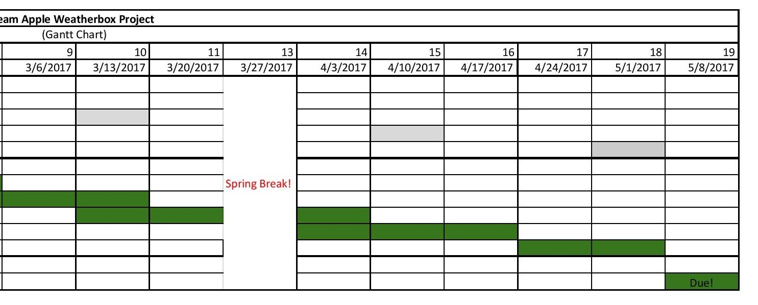
In two or three columns
Gantt Chart

Slide 13
Thanks!
ANY QUESTIONS?

