Slide 1
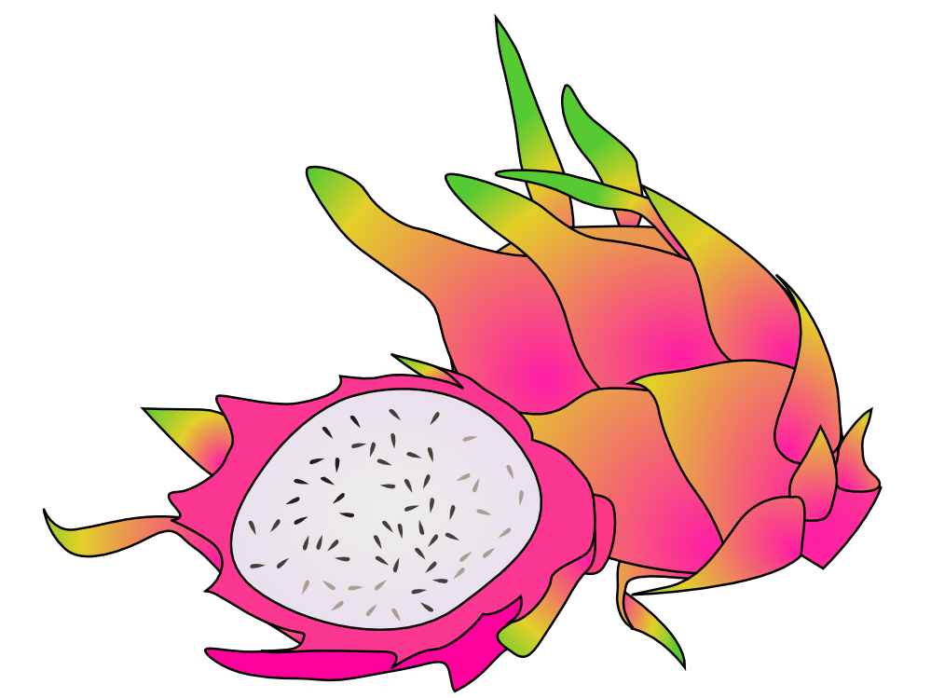
EE 496 Dragon Fruit Proposal Presentation
Brian Chan
Garrett Young
Advisor: Anthony Kuh
September 26, 2015

Slide 2
Introduction
Brian Chan
Garrett Young

Slide 3
Overview
Introduction
Motivation
Learning Objectives
Approach & Schedule
Problems
Notes:
Brian
Today we will be talking about what we are working on, the motivation behind it, some of the learning objectives we hope to achieve, our plans for approach and timeline to achieve it and lastly the problems we may encounter along the way.

Slide 4
What is Dragon Fruit?
Bleeding edge weatherbox design
addresses issues from Cranberry and Apple
Goals for this semester:
Research and design a new board
Get a working prototype by end of November
Notes:
Brian

Slide 5
Motivation
Improvements on its predecessor Cranberry
Provide better sensor data
Lower power consumption
Lower cost
Notes:
Garrett

Slide 6
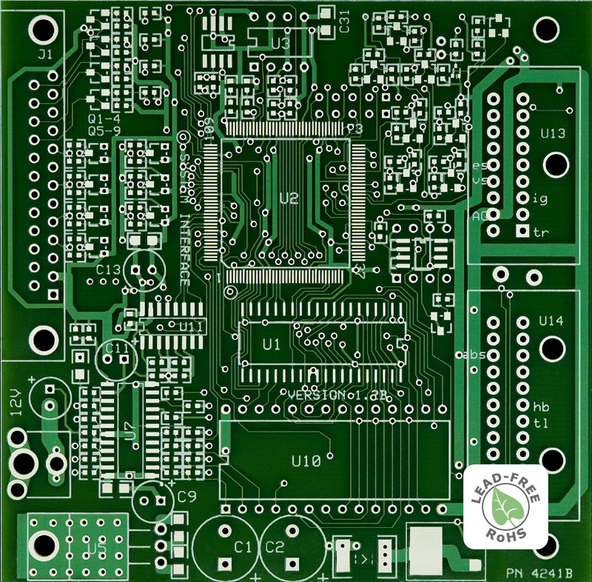
Learning Objectives
Professionalism
PCB Design Rules
Work with new SMD parts
Documentation
Notes:
Garrett

Slide 7
Tentative Schedule
Read & understand Cranberry Designs
September
Pick new parts
September - October
Test all parts
October
Design 1st iteration of Dragon Fruit
November
Test the 1st design
Notes:
Brian
picking parts, making sure the power system works

Slide 8
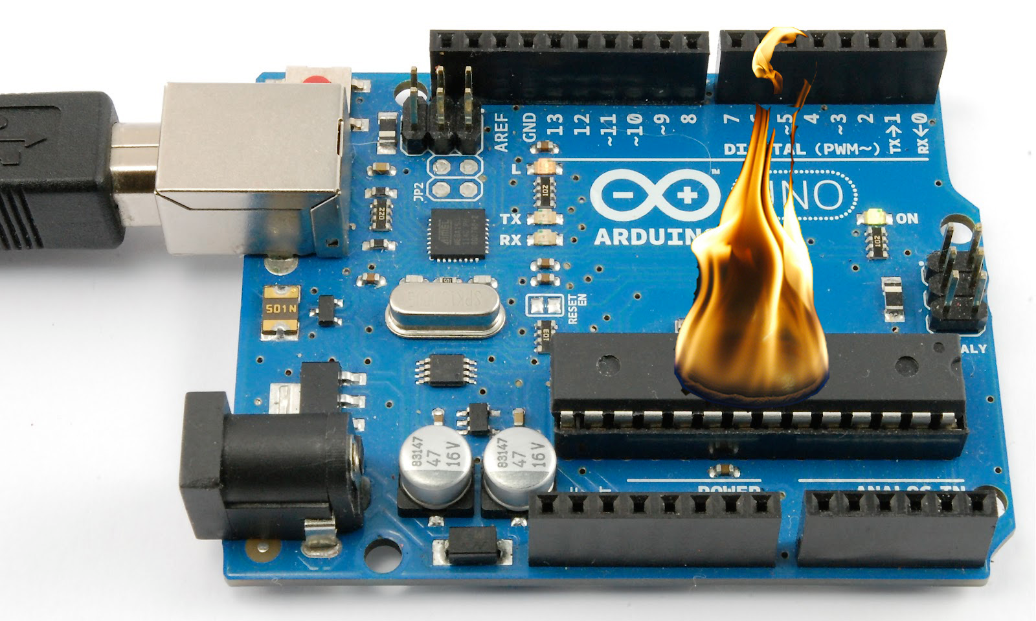
Problems?
Testing/burning IC parts
Soldering problems
bridging/shorting connections
Notes:
Garrett

Slide 9
Conclusion
Motivation
Learning Objectives
Approach & Schedule
Problems
Notes:
Brian

Slide 10
Questions?
Notes:
Garrett jk jk but seriously I geffum

Slide 11
Image Sources
http://www.clipartlord.com/wp-content/uploads/2013/01/dragon-fruit.png
http://www.expresspcb.com/wp-content/uploads/2015/06/PhotoProductionPCB_LF_800.jpg
http://previews.123rf.com/images/dvarg/dvarg1312/dvarg131200069/24395877-Cartoon-cranberry-with-green-leaves-on-white-background--Stock-Vector.jpg
https://paramountmechatronics.files.wordpress.com/2012/11/burned-out.jpg
http://s974.photobucket.com/user/dlh1231/media/dragonite.png.html

