Slide 1
Preliminary Design Review
Team Black Hole:
Katherine Shun
Makamae Carpenter
Janiene Scovell
Mentor: Brandon Amano
1

Slide 2
Overview
Overview
Block Diagram
Hardships
Teamwork
Progress
Gantt Chart
Questions!
2

Slide 3
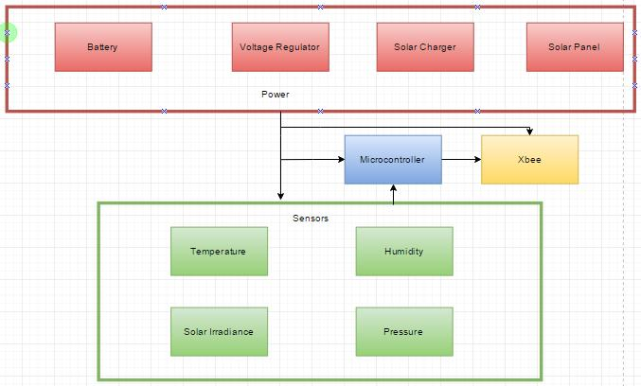
Block Diagram
3

Slide 4
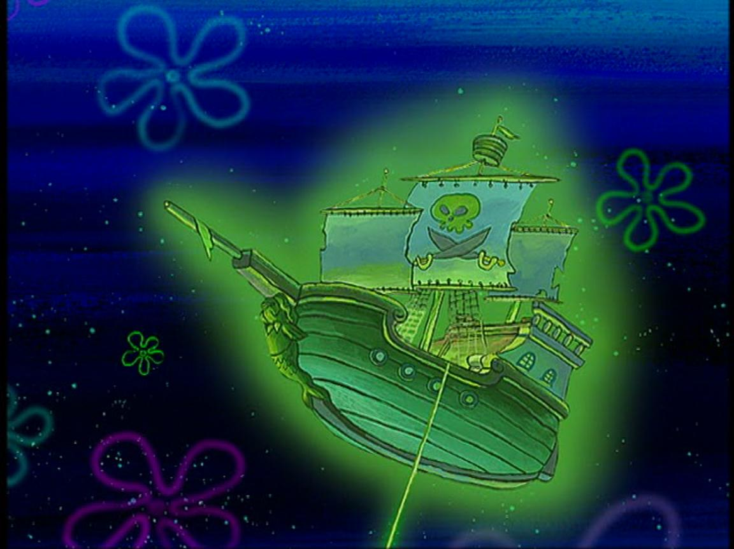
Hardships
Getting parts in time
Build fully operational Weatherbox
Find improvements to current / past designs
4

Slide 5
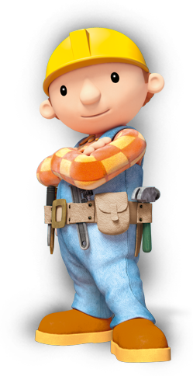
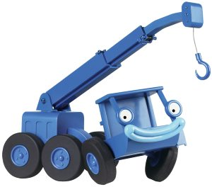
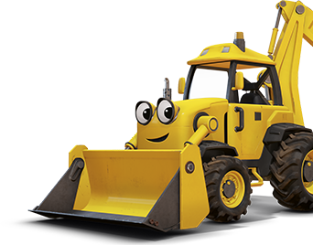
Teamwork
Makamae = Parts specialist
Kat = Soldering specialist
Janiene = Organization specialist
Together =
Github
Eagle Schematics
Bare Arduino
Started on Sensors
Grown as a team
Mak
Kat
J9
5

Slide 6
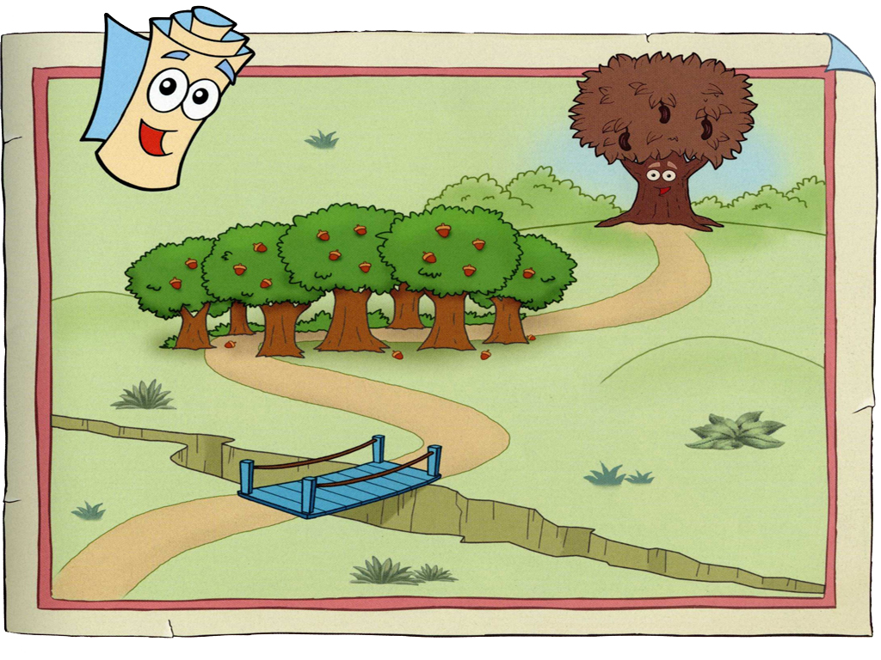
Progress
Training ✓
Research Modules✓
Build ✓
Test/Debug
Demonstrate
Final Report
Make Brandon proud
Weatherbox
Team Blackhole
6

Slide 7
Schedule:
7

Slide 8
Questions?
8

