Slide 1
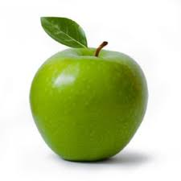
Proposal Presentation
Team Apple
Mentor: Tryston Fagarang
Advisor: Dr. Anthony Kuh

Slide 2
Kenny-Lee Fujioka
Junior in EE (EP track)
Interested in hardware and software

Slide 3
Kyaw Hein
Team Lead
Junior in EE (EP Track)
Interested in Renewable energy, Hardware and circuit designs

Slide 4
Makamae Carpenter
Junior
Electrical Engineering: Electrophysics
Looking for a serious relationship with my PCB board
Interested in Hardware, Programming, and also Processor Design

Slide 5
Overview: What is Apple?
The very first generation of the Weatherbox family
It collects weather data
The main purpose of the Weatherbox is to predict solar patterns
Notes:
Such as solar irradiance, temperature, humidity and pressure
to optimize the locations for solar panels mainly throughout UH Campus

Slide 6
Overview: Apple

Slide 7
Goals
Optimize the latest version of Apple hardware
Debug/Understand the Apple board
Use previous housing design
Complete a working Weatherbox
Improve/Redesign a new version of Apple

Slide 8
Approach & Problems
Approach:
Get current version of Apple board
Troubleshoot
Finish and deploy Weatherbox
Problems:
Short amount of time
Completely new board (new parts, design)

Slide 9
Learning Expectations
Eagle
SolidWorks/Sketchup
Implementation
Soldering
PCB Design
Working faster
Everyone’s names

Slide 10
Gantt Chart

Slide 11
Any Questions?

