Slide 1
Wind Sensor
Critical Design Review
Keoni
Scott
Alex
Bin

Slide 2
Overview
Block Diagram
Schematic
Code
Progress Since PDR
What We Still Need to Finish

Slide 3
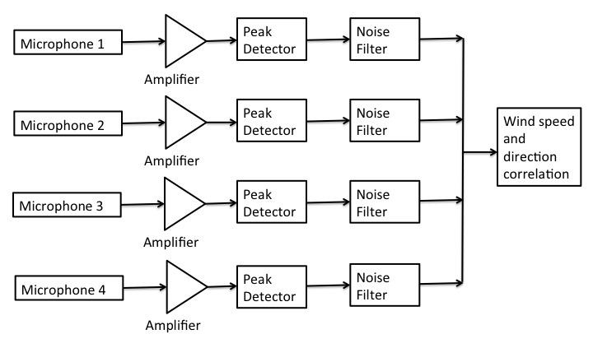
Block Diagram

Slide 4
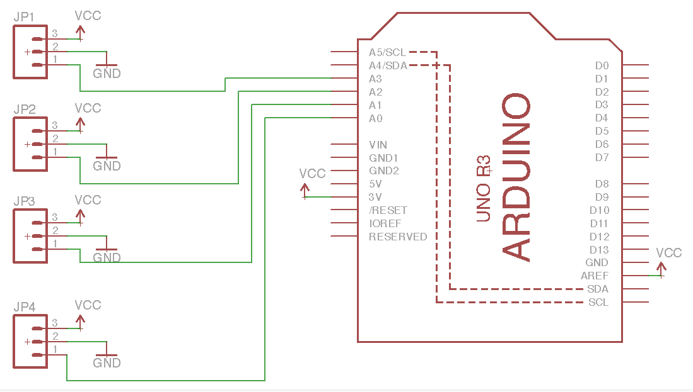
Schematic

Slide 5
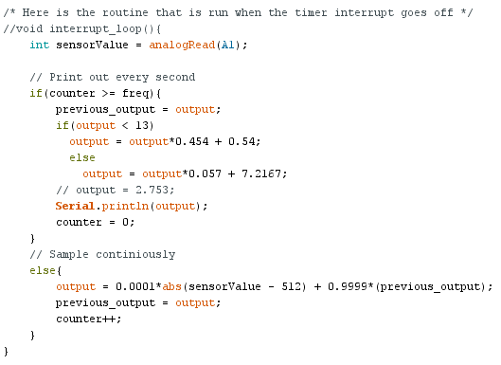
Code

Slide 6
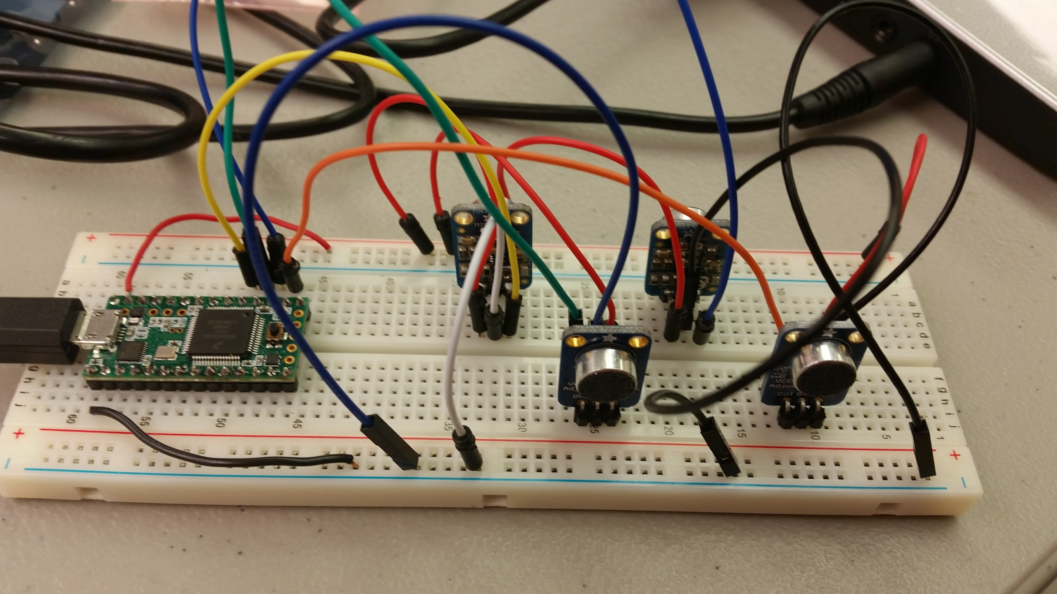
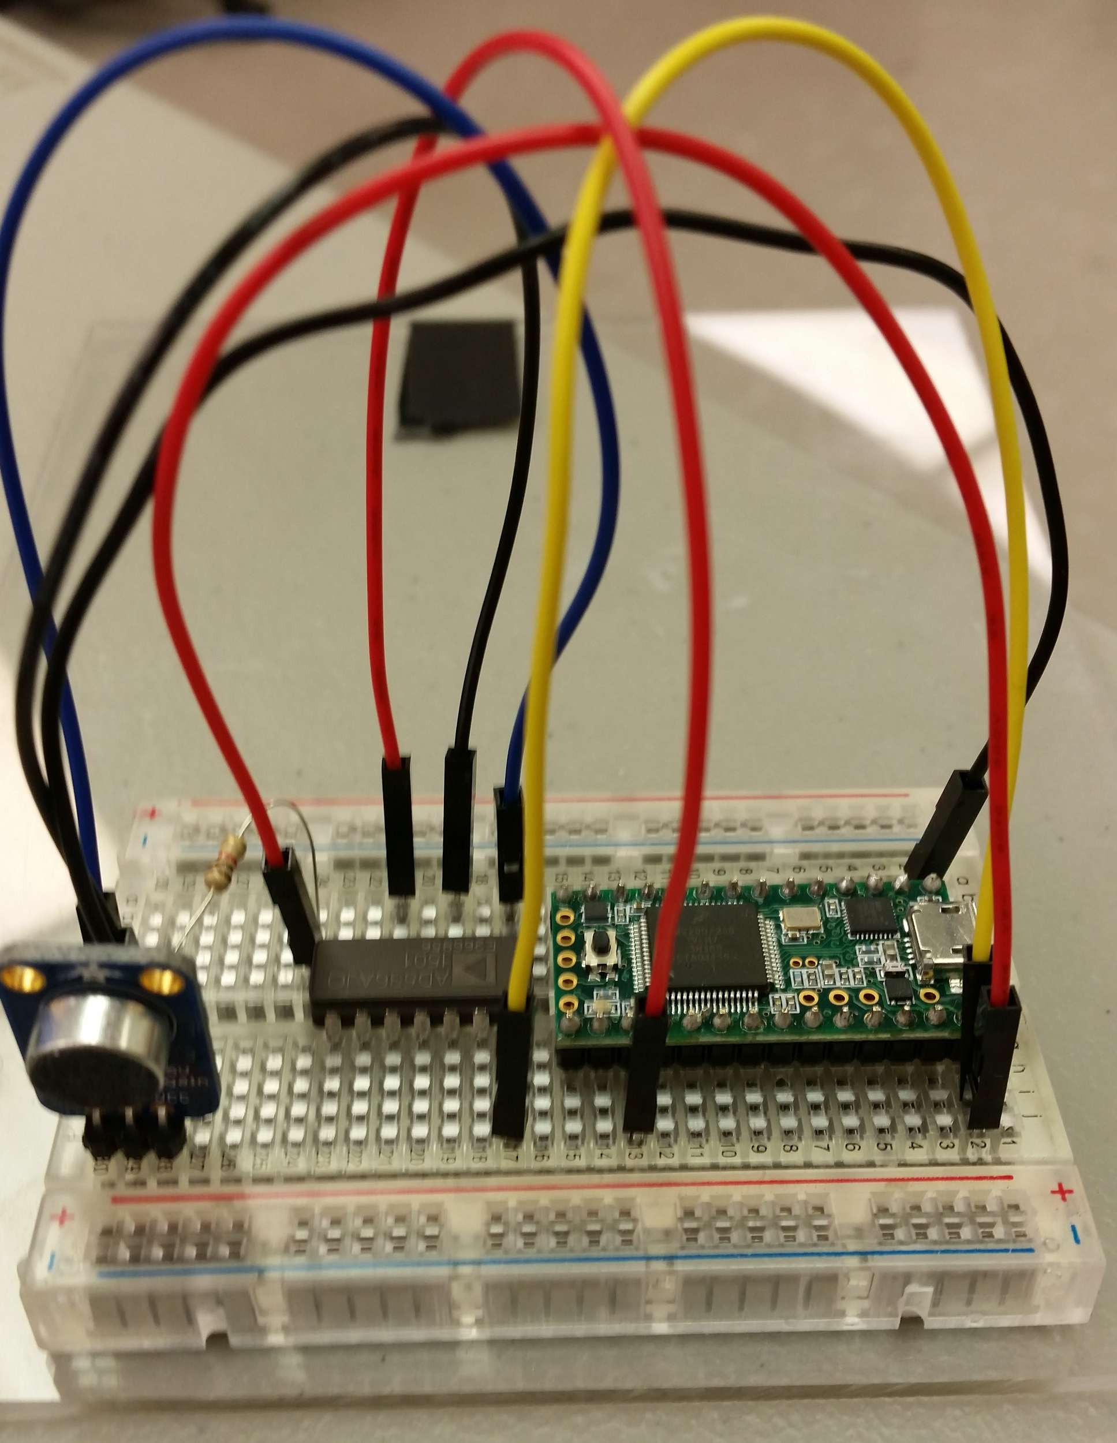
Progress since PDR
Finished single and four microphone setup on Teensy
Gathered test data
Researched RMS to DC chip and how to test it (Bin)
Researched new anemometer with UART capabilities (Scott)
Started re-writing Wind Sensor report

Slide 7
What We Still Need to Finish
Design and fabricate a PCB for four microphone setup with Cortex M4 chip
Purchase new anemometer
Test four microphone setup
Finish testing RMS chip
Rewrite Report
Design Housing
Order Parts

Slide 8
Questions?

