Slide 1
Weather Box Proposal
Team Black Hole - Mentor: Brandon
Katherine (Kat), Makamae (Mak), Janiene (J9)
Notes:
spend more time introducing ourselves… name, major, interests, hobbies.

Slide 2
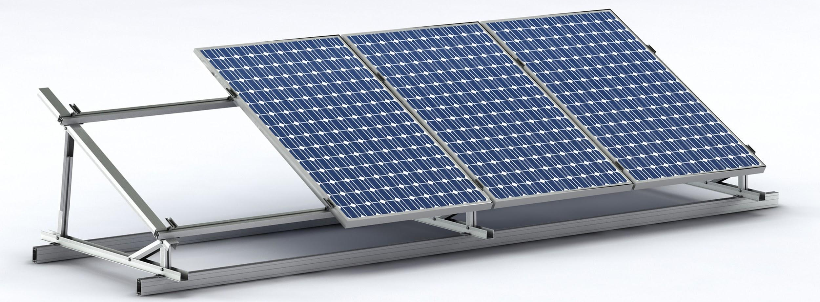
Motivations for this Project
Develop a device that can take measurements to help make plans for future renewable energy use
Low-cost, Accurate, Reliable
Optimize solar panel placements
Kat
Mak
J9
Notes:
elaborate on measurements

Slide 3
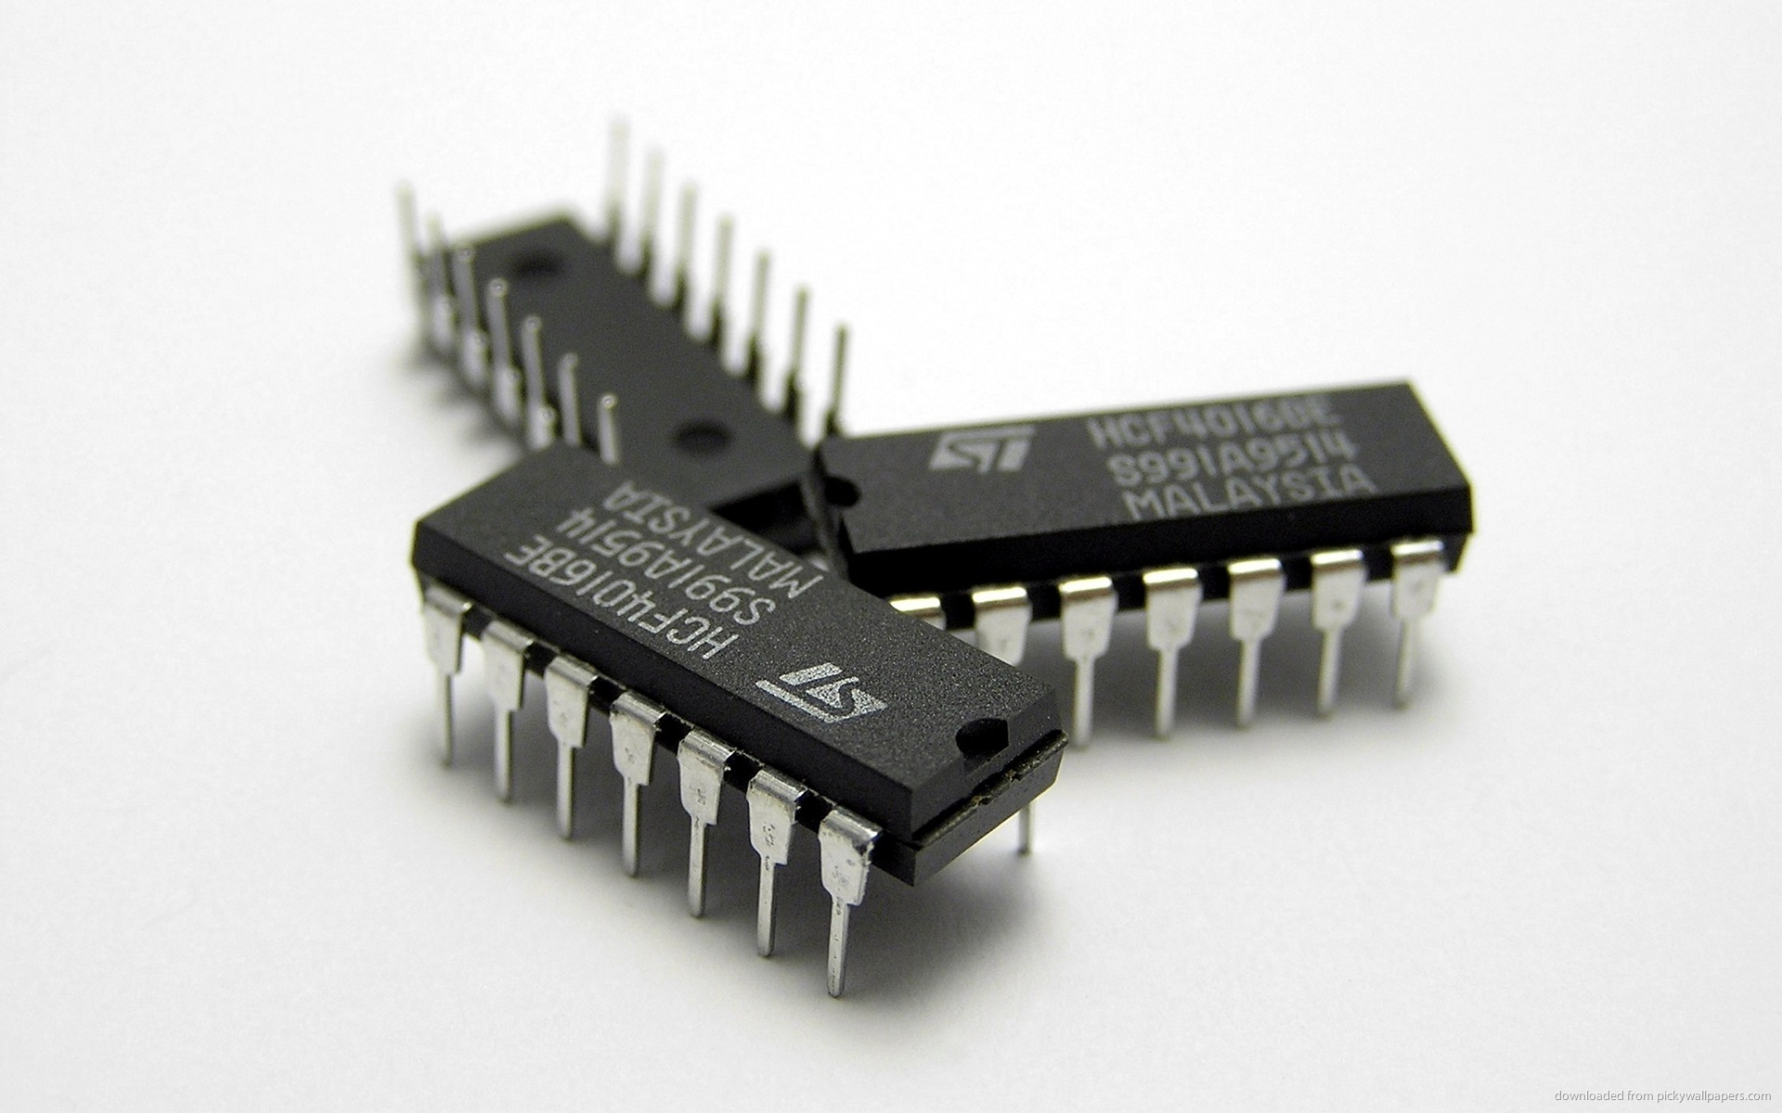
Project Overview
Training
Modules
Build
Test/Debug
Demonstrate
Final Report
Mak
J9
Kat
Notes:
elaborate on modules

Slide 4
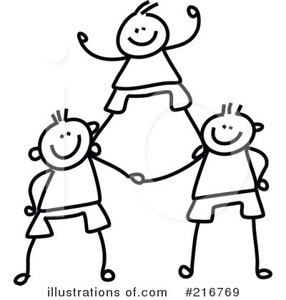
Goals
Build fully operational Weatherbox
Find improvements to current / past designs
Teamwork
Mak
J9
Kat

Slide 5
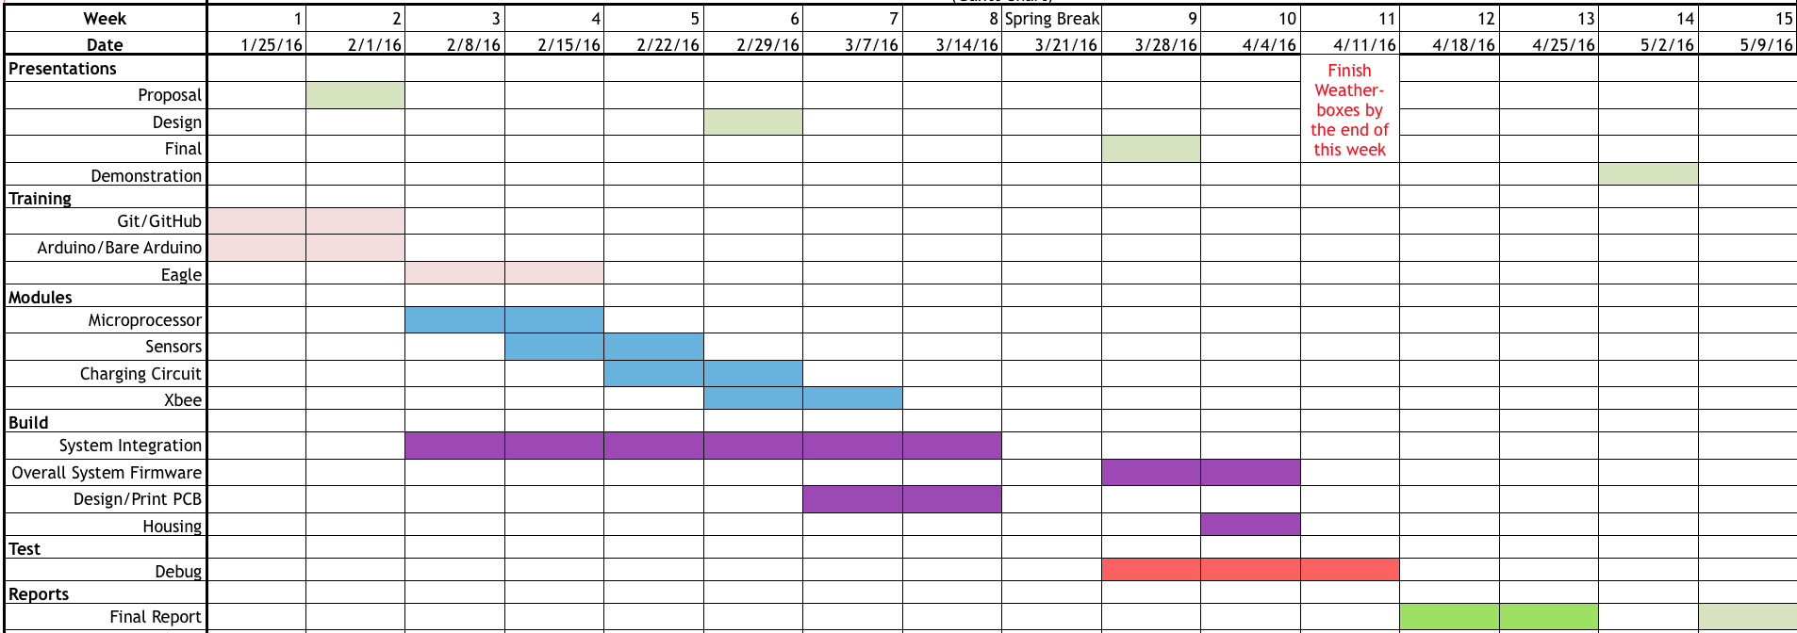
Timeline

Slide 6
Questions?
“One way in, no way out.”

