Slide 1
Dragon Fruit
University of Hawaii at Manoa SCEL
Keane Hamamura
Kevin Wong
Tyler Yamauchi
Mentor: Demosthenes Villa
Advisor: Anthony Kuh

Slide 2
Overview
University of Hawaii at Manoa SCEL
Introduction
Project Overview
Goals for Semester
Schedule
Potential Problems
Learning Objectives
Updates (Team’s Progress)
Next Steps
1
Notes:
Short term goals: Make sure current Dragon Fruit board is operational, if not make it operational. Then send it out in a temporary box to gather data.
Long term goals: Redesign the Dragon Fruit board, fixing the current problems affecting the board (phantom voltage, excess current draw), and implement GPS, real time clock, and swap out parts for more efficient ones. Hopefully create the board, print out a box and send it out.
Problems with current board: Only lasts for 2 days.

Slide 3
Introduction
University of Hawaii at Manoa SCEL
Kevin Wong (Team Lead)
Junior in EE (EP Track)
Tyler Yamauchi
Junior in EE (EP Track)
Keane Hamamura
Junior in EE (Systems Track)
Dragon Fruit
2

Slide 4
Project Overview
University of Hawaii at Manoa SCEL
Bleeding edge weatherbox design
Addresses issues from Cranberry and Apple
Provide better sensor data
Lower power consumption
Lower cost
3

Slide 5
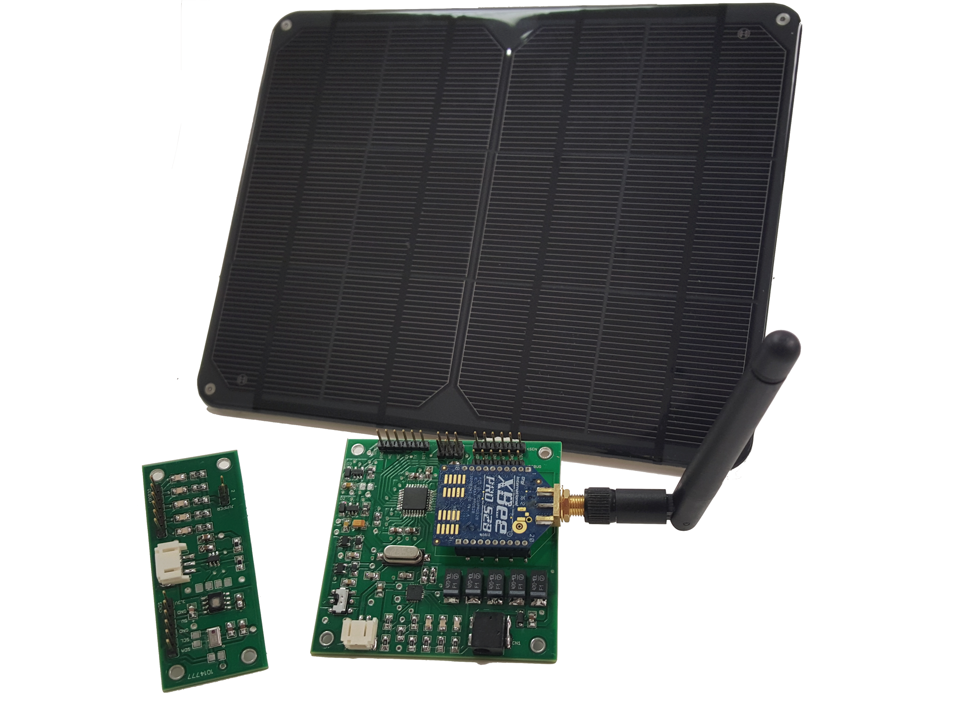
Goals for this Semester
University of Hawaii at Manoa SCEL
Debug
Ghost Voltage
Excess current draw
House Circuit
Deploy
Redesign PCB
GPS
Real Time Clock
More efficient parts
4
Notes:
Short term goals: Make sure current Dragon Fruit board is operational, if not make it operational. Then send it out in a temporary box to gather data.
Long term goals: Redesign the Dragon Fruit board, fixing the current problems affecting the board (phantom voltage, excess current draw), and implement GPS, real time clock, and swap out parts for more efficient ones. Hopefully create the board, print out a box and send it out.
Problems with current board: Only lasts for 2 days.

Slide 6
Schedule
University of Hawaii at Manoa SCEL
Learning and Debugging
Finalize New Schematic/PCB
Debug/Deploy
OCT
NOV
SEPT
DEC
Debugging/Research
Draft Schematic/PCB

Slide 7
Potential Problems
University of Hawaii at Manoa SCEL
Not able to solve ghost voltage and current draw
Efficient parts might be more expensive
PCB size increase
Not able to redesign PCB in time
Soldering Problems
Notes:
Soldering Problems - Bridging/shorting connections

Slide 8
Learning Objectives
University of Hawaii at Manoa SCEL
Learn hardware design tools (Eagle)
Improve soldering techniques
Improve Circuit/PCB Design Rules

Slide 9
Updates
University of Hawaii at Manoa SCEL
Dragonfruit housing prototype completed
Learning different components on the PCB board
Reading datasheets and previous Dragon Fruit documents

Slide 10
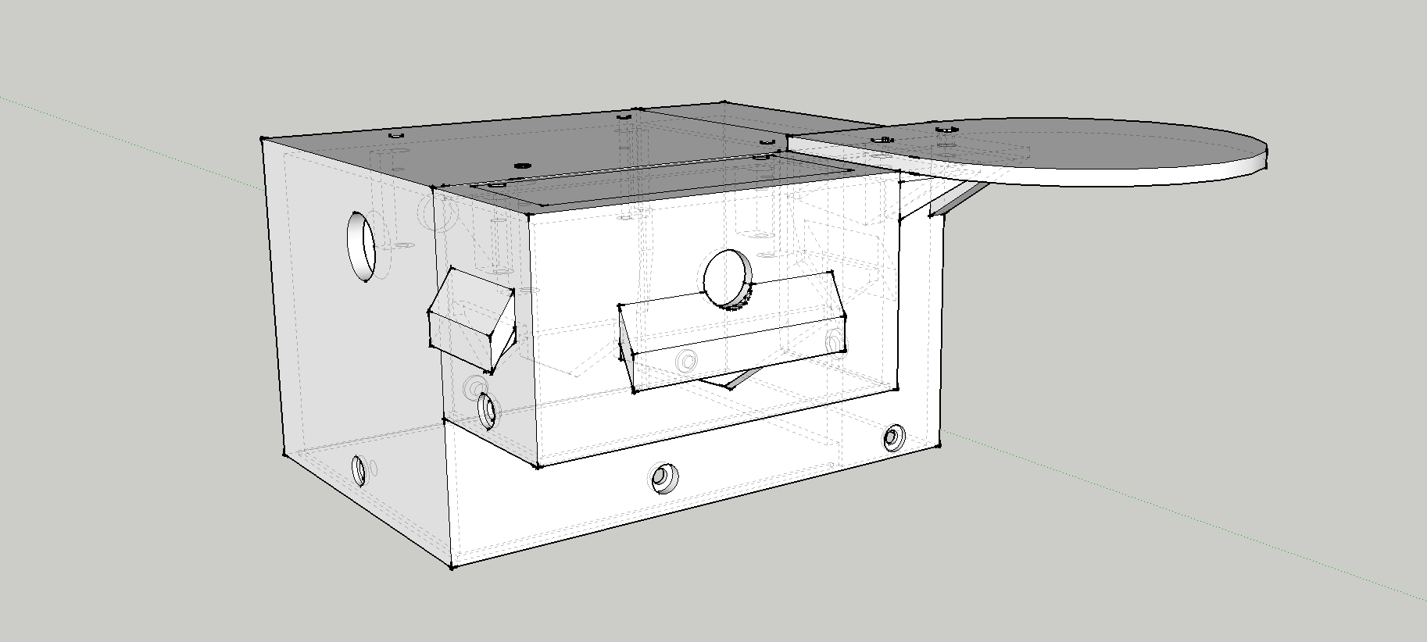
Housing
University of Hawaii at Manoa SCEL

Slide 11
Next Steps
University of Hawaii at Manoa SCEL
Continue learning how Dragon Fruit works
Lack of knowledge
Debug circuit board
Start research for GPS and real time clock
Run performance tests on circuit

Slide 12
Questions?

Slide 13
Image Sources
http://cryptid-creations.deviantart.com/art/Daily-Paint-1081-Dragon-Fruit-Keeper-570702189
http://www.michaelleestallard.com/wp-content/uploads/Hello-My-Name-Is-Name-Badge.jpg

