Slide 1
Project Badger
Kyle Chan
Cyrus Noveloso
Brianne Tengan

Slide 2
The Team
Mentor:
Zachary Dorman
Members:
Kyle Chan
Cyrus Noveloso
Brianne Tengan

Slide 3
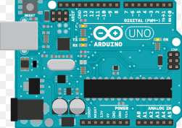
Semester Plan
Learn basics of Arduino
Research relevant sensors and XBee Transceivers
Create firmware
Design a Printed Circuit Board
Assemble Project

Slide 4
Motivation
Learn EE concepts and skills
Save electricity
Save money
Save me!

Slide 5
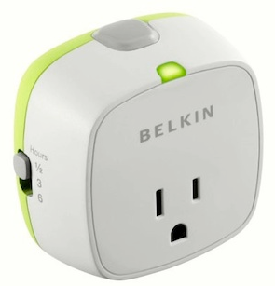
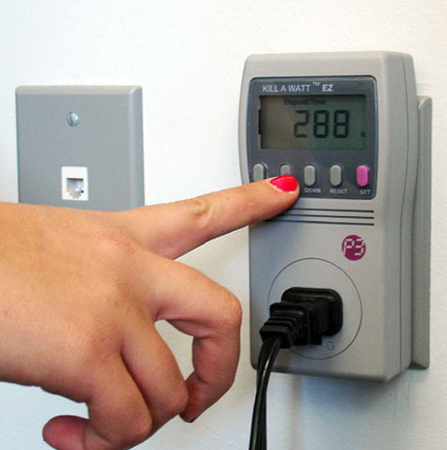
Project Overview
Smart Outlet
Design an outlet that can be turned off wirelessly through the use of an XBee
Monitor how much electricity is being used by the outlet
Set timer/schedule on electrical output to certain appliances
Notes:
outlet: xbee connects to xbee shield on arduino
cut power to an outlet wirelessly (analog)

Slide 6
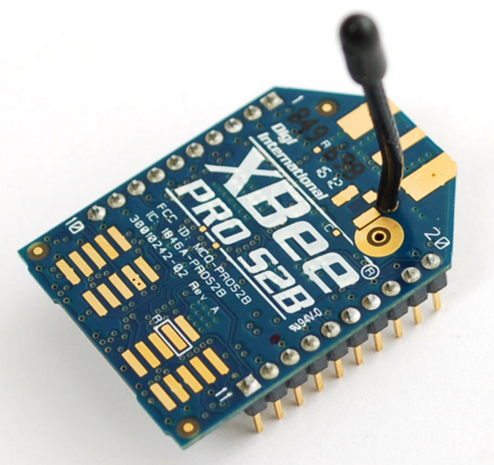
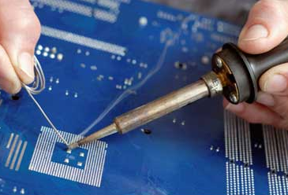
Goals
Learn workplace skills:
communication, organization, interpersonal, analytical thinking, time management, teamwork, enthusiasm, professional behavior
Learn technical skills:
programming, soldering, PCB design
More specifically:
how to use an XBee, Arduino, 3D print, Eagle

Slide 7
Thank you! Questions?

