Slide 1
Critical Design Review
Team Black Hole:
Katherine Shun
Makamae Carpenter
Janiene Scovell
Mentor: Brandon Amano
1
Notes:
Katherine

Slide 2
Overview
Block Diagrams
Progress Thus Far
Plans for Future & Gantt Chart
Questions
2
Notes:
Katherine

Slide 3
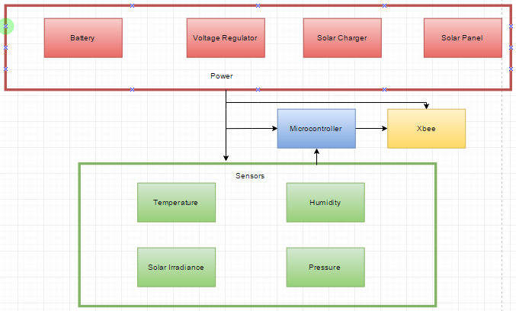
Overall Block Diagram
3
Notes:
Makamae

Slide 4
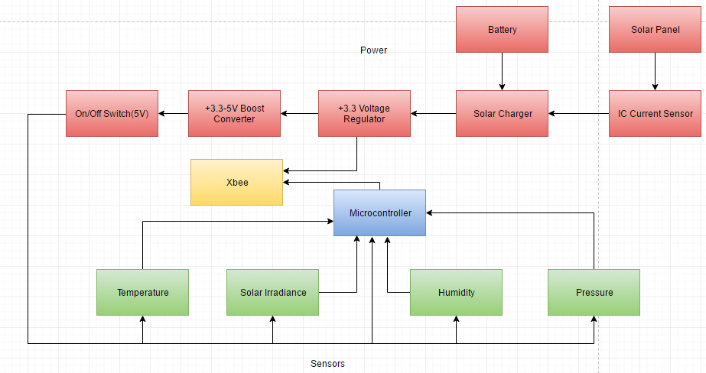
Detailed Block Diagram
4
Notes:
Makamae

Slide 5
Pseudo Code/Algorithm for Integrated Code
Include all necessary libraries
Define all necessary pins
Initialize variables
Start up sensors to read at standard baud rate (9600)
Receive data from sensors
Temperature
Solar Irradiance
Humidity
Pressure
Convert data from sensors into necessary unit readings
Print unit readings in serial monitor
Intervals of 2 seconds
5
Notes:
Katherine

Slide 6
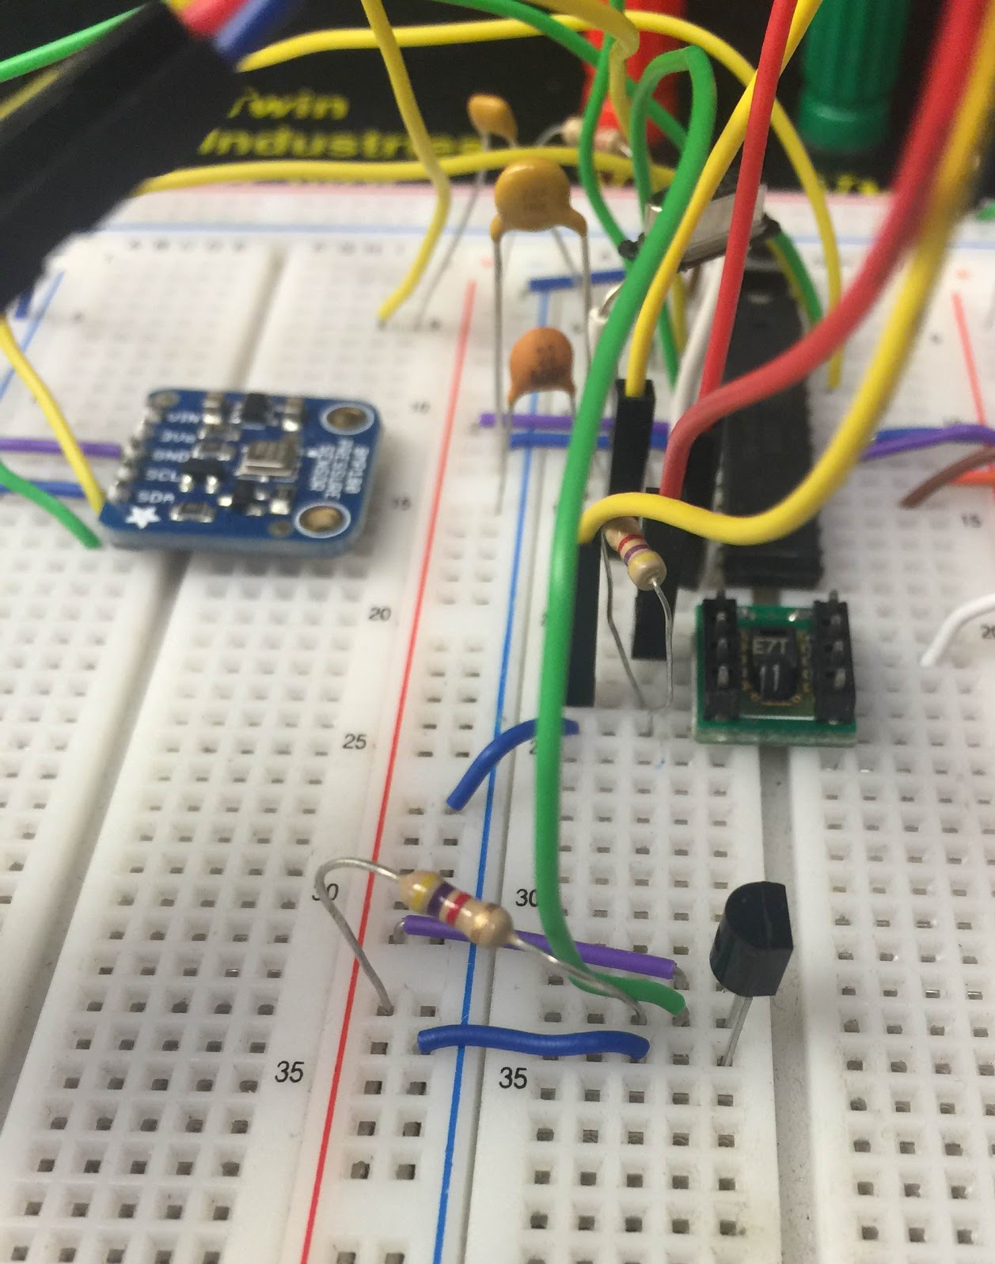
Progress
All sensors tested successfully
Obstacles:
Software vs. Hardware pins
Wiring mistakes
6
Notes:
Katherine

Slide 7
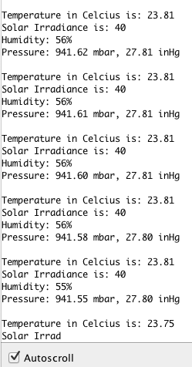
Progress (cont.)
Integrated sensor code
Obstacles:
Integrating everything all at once vs. one by one
7
Notes:
Janiene

Slide 8
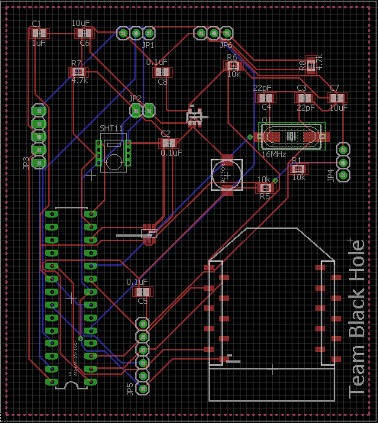
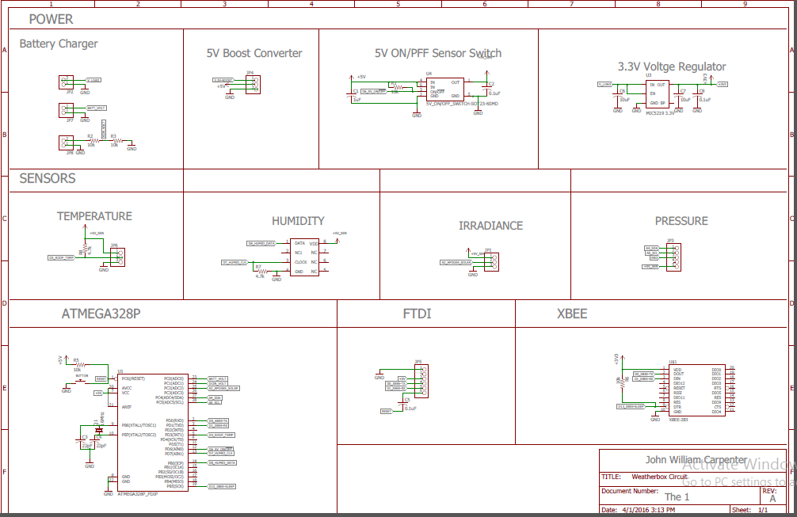
Progress (cont.)
Initial PCB design finished
Adding charging circuit
Change SHT11 pad size
Change button from SM to Through Hole
Change trace size and space them out
8
Notes:
Makamae

Slide 9
Plans
XBee: Working on sending and receiving packages
Housing: To be done on Monday with Brianne Yamada
PCB Board Printing: To be done next week with Tyrin
9
Notes:
Janiene (XBee), Katherine (Housing), Makamae (PCB Printing)

Slide 10
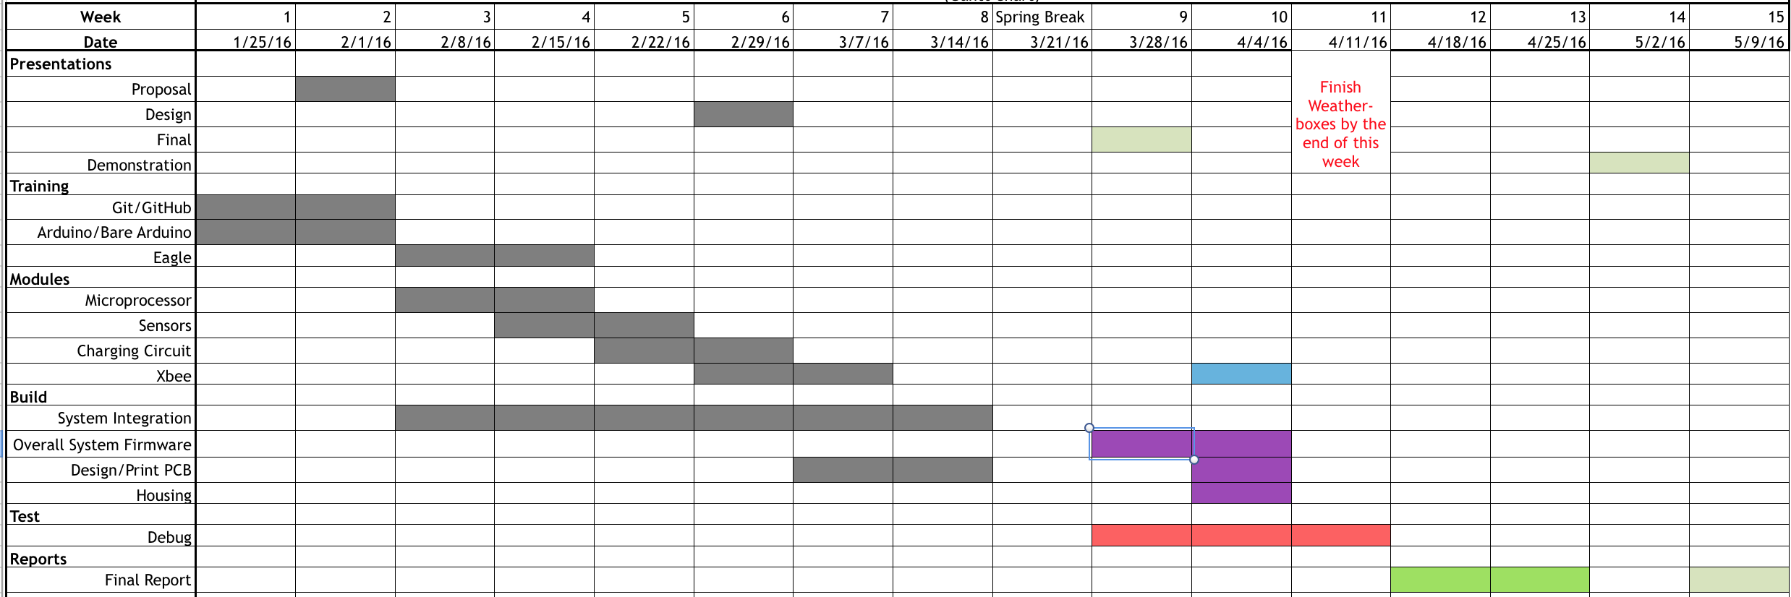
Current Gantt Chart:
10
Notes:
Janiene

Slide 11
Questions?
#TeamBrandon
11
Notes:
Katherine

