Slide 1
Project Badger
Final Presentation / Demo
Kyle Chan
Cyrus Noveloso
Brianne Tengan
Zachary Dorman

Slide 2
Overview
How it works
Design choices
Special features

Slide 3
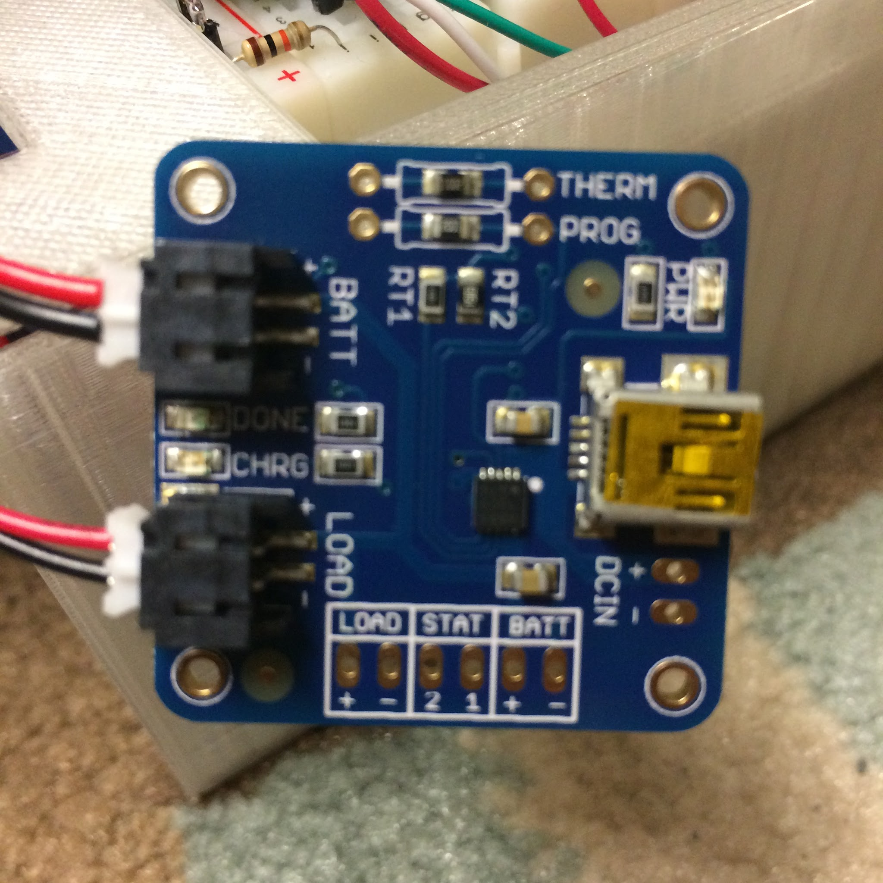
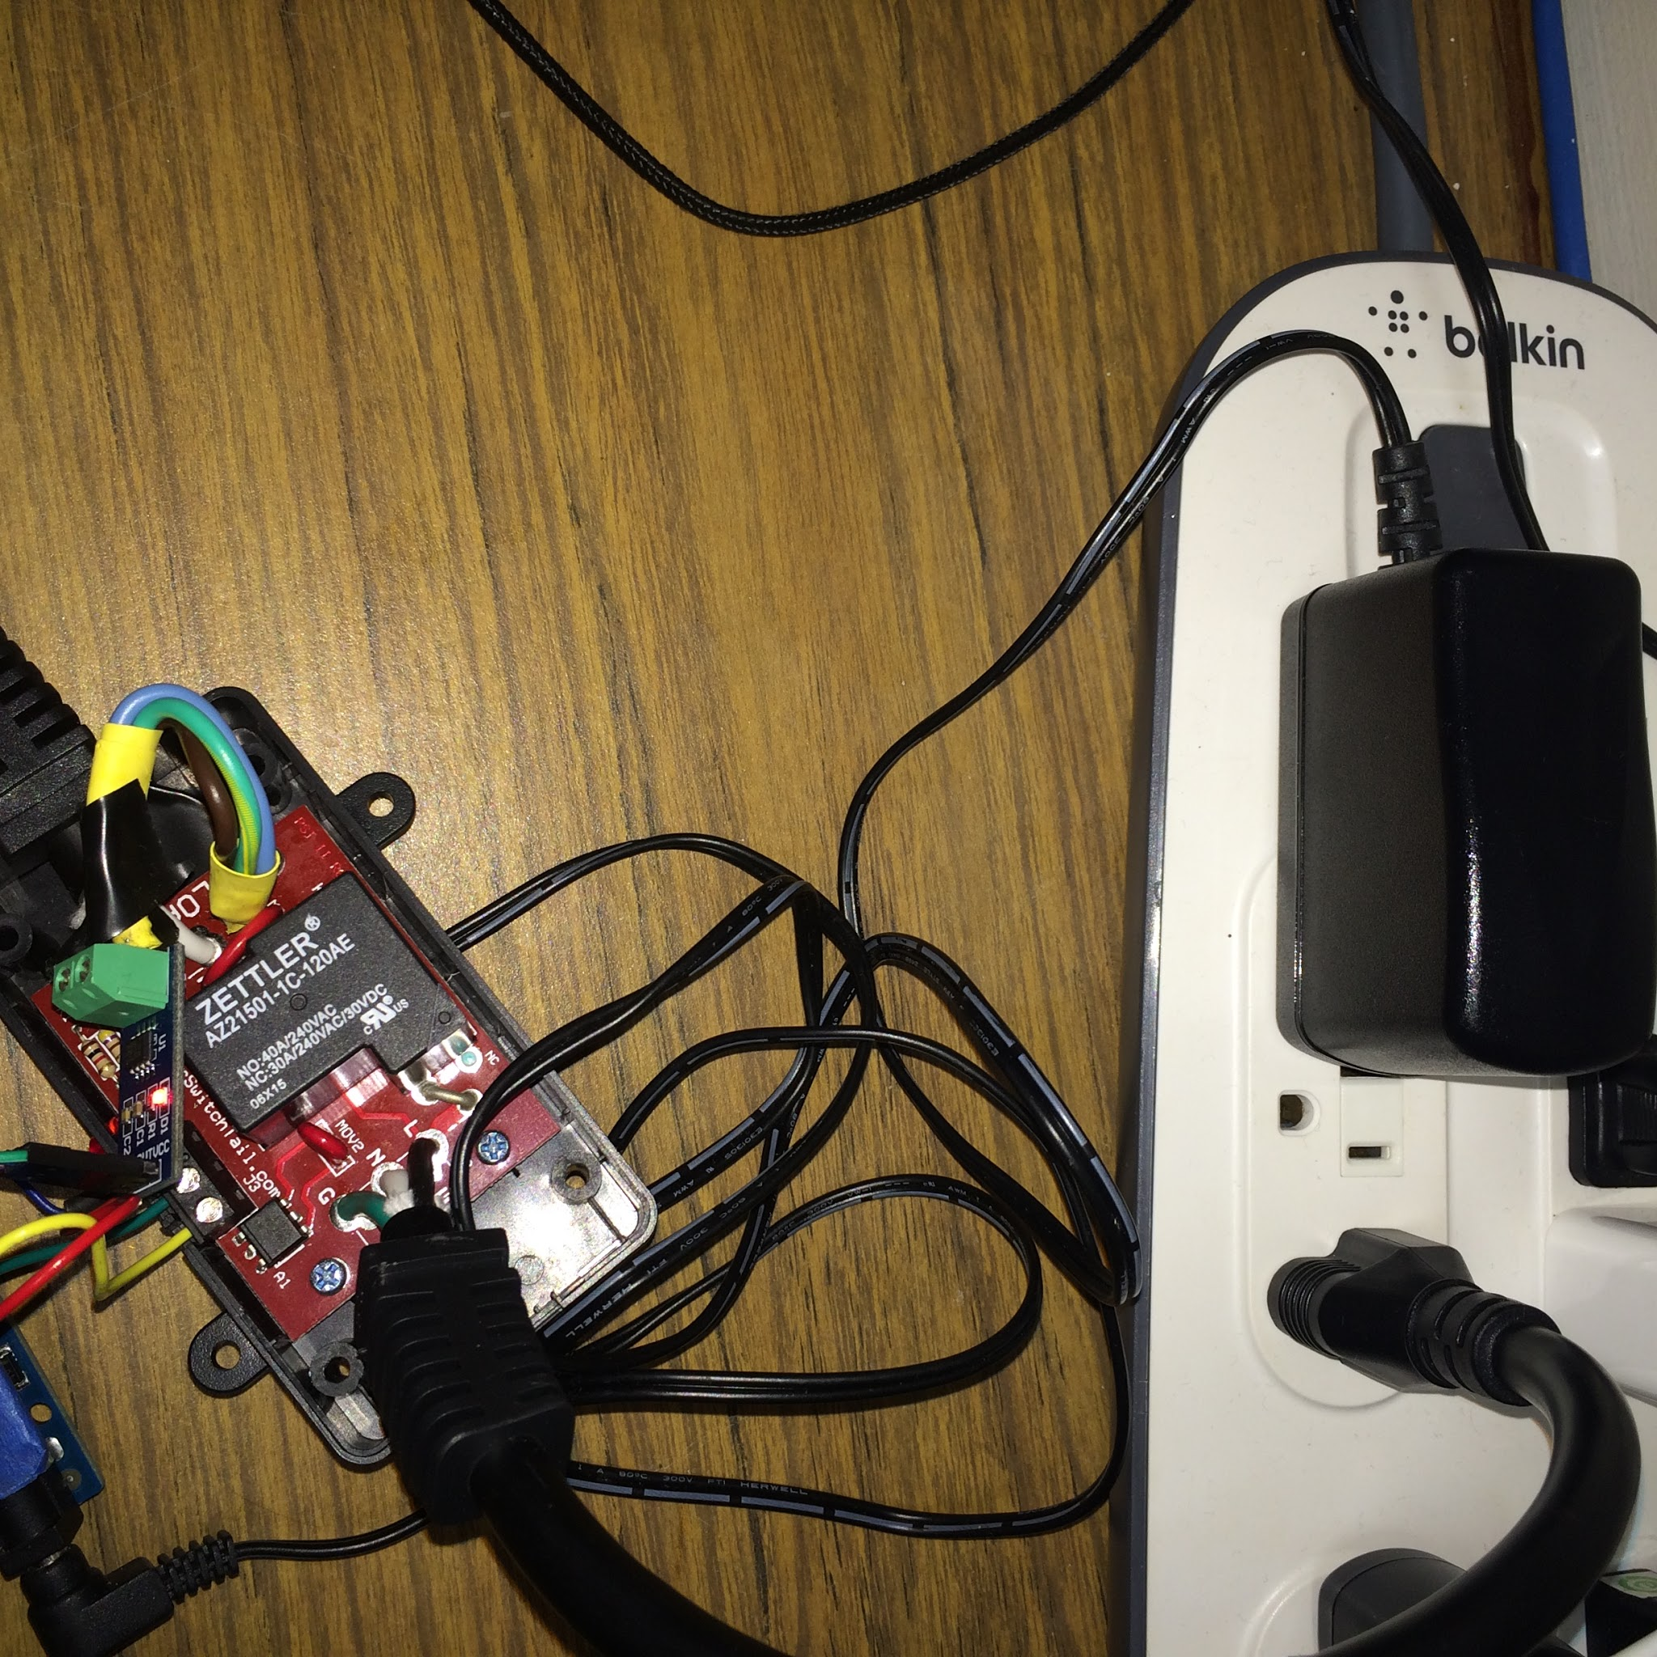
Setup
Control Setup
Plug in battery
Outlet Setup
Plug in power switch
Plug in DC adapter
Connect appliance/power strip

Slide 4
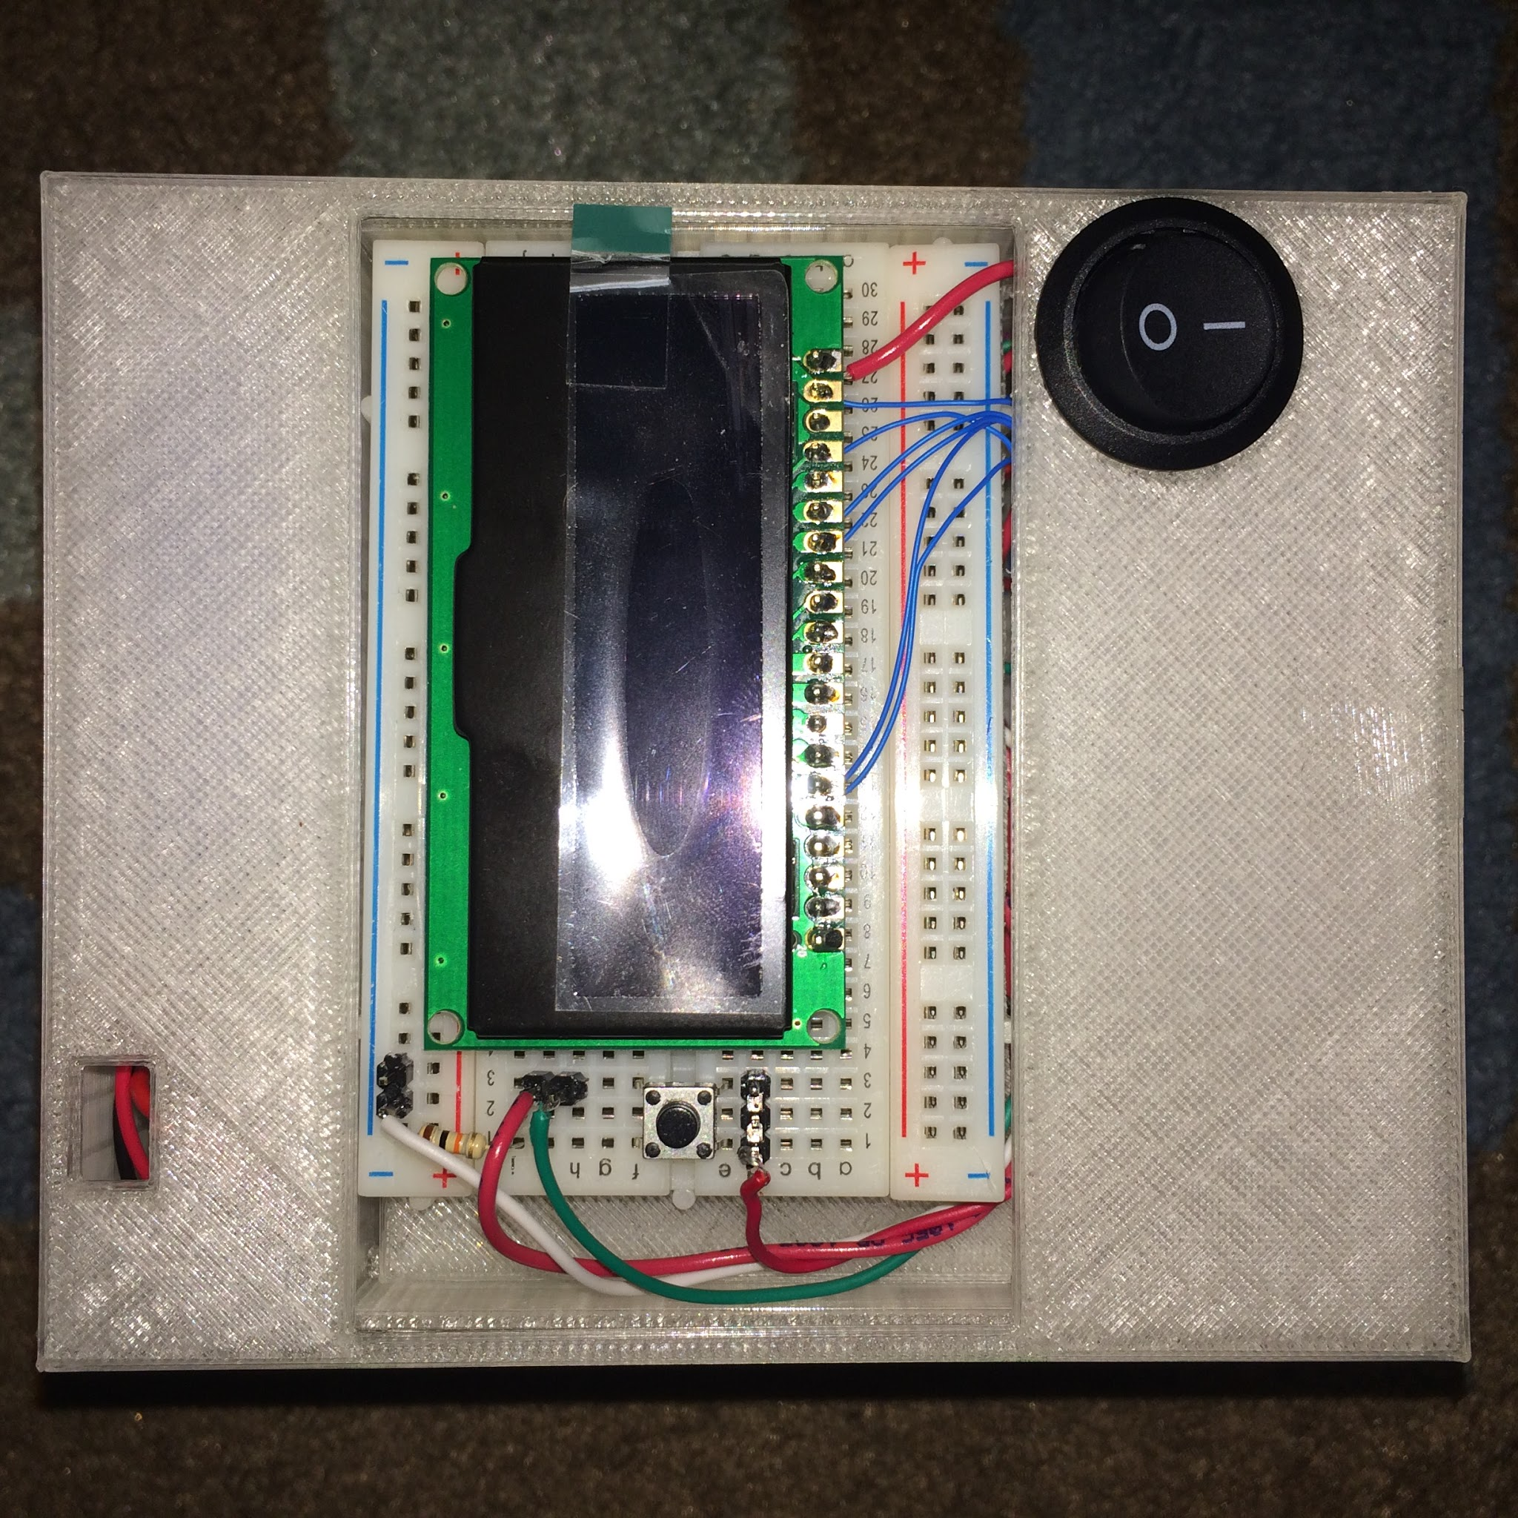
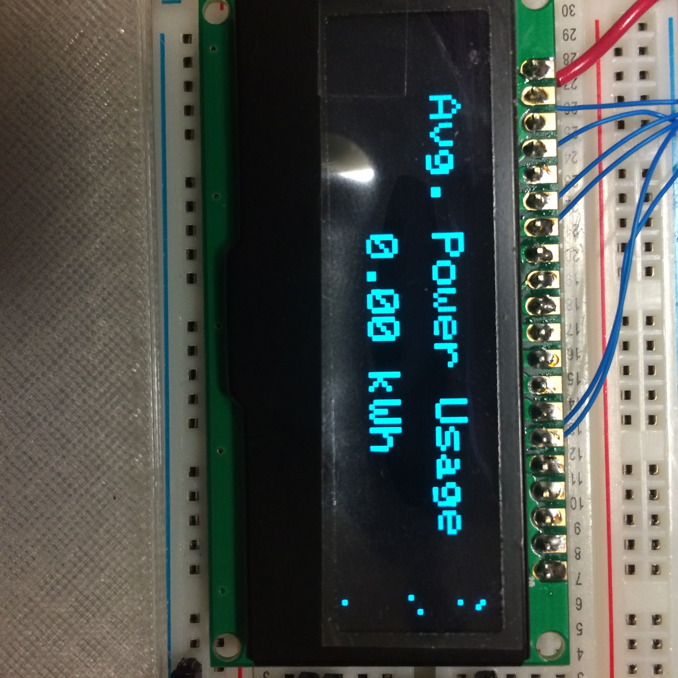
Operation
How to use
Press switch to toggle power state of appliance
Press button to display power draw on LCD

Slide 5
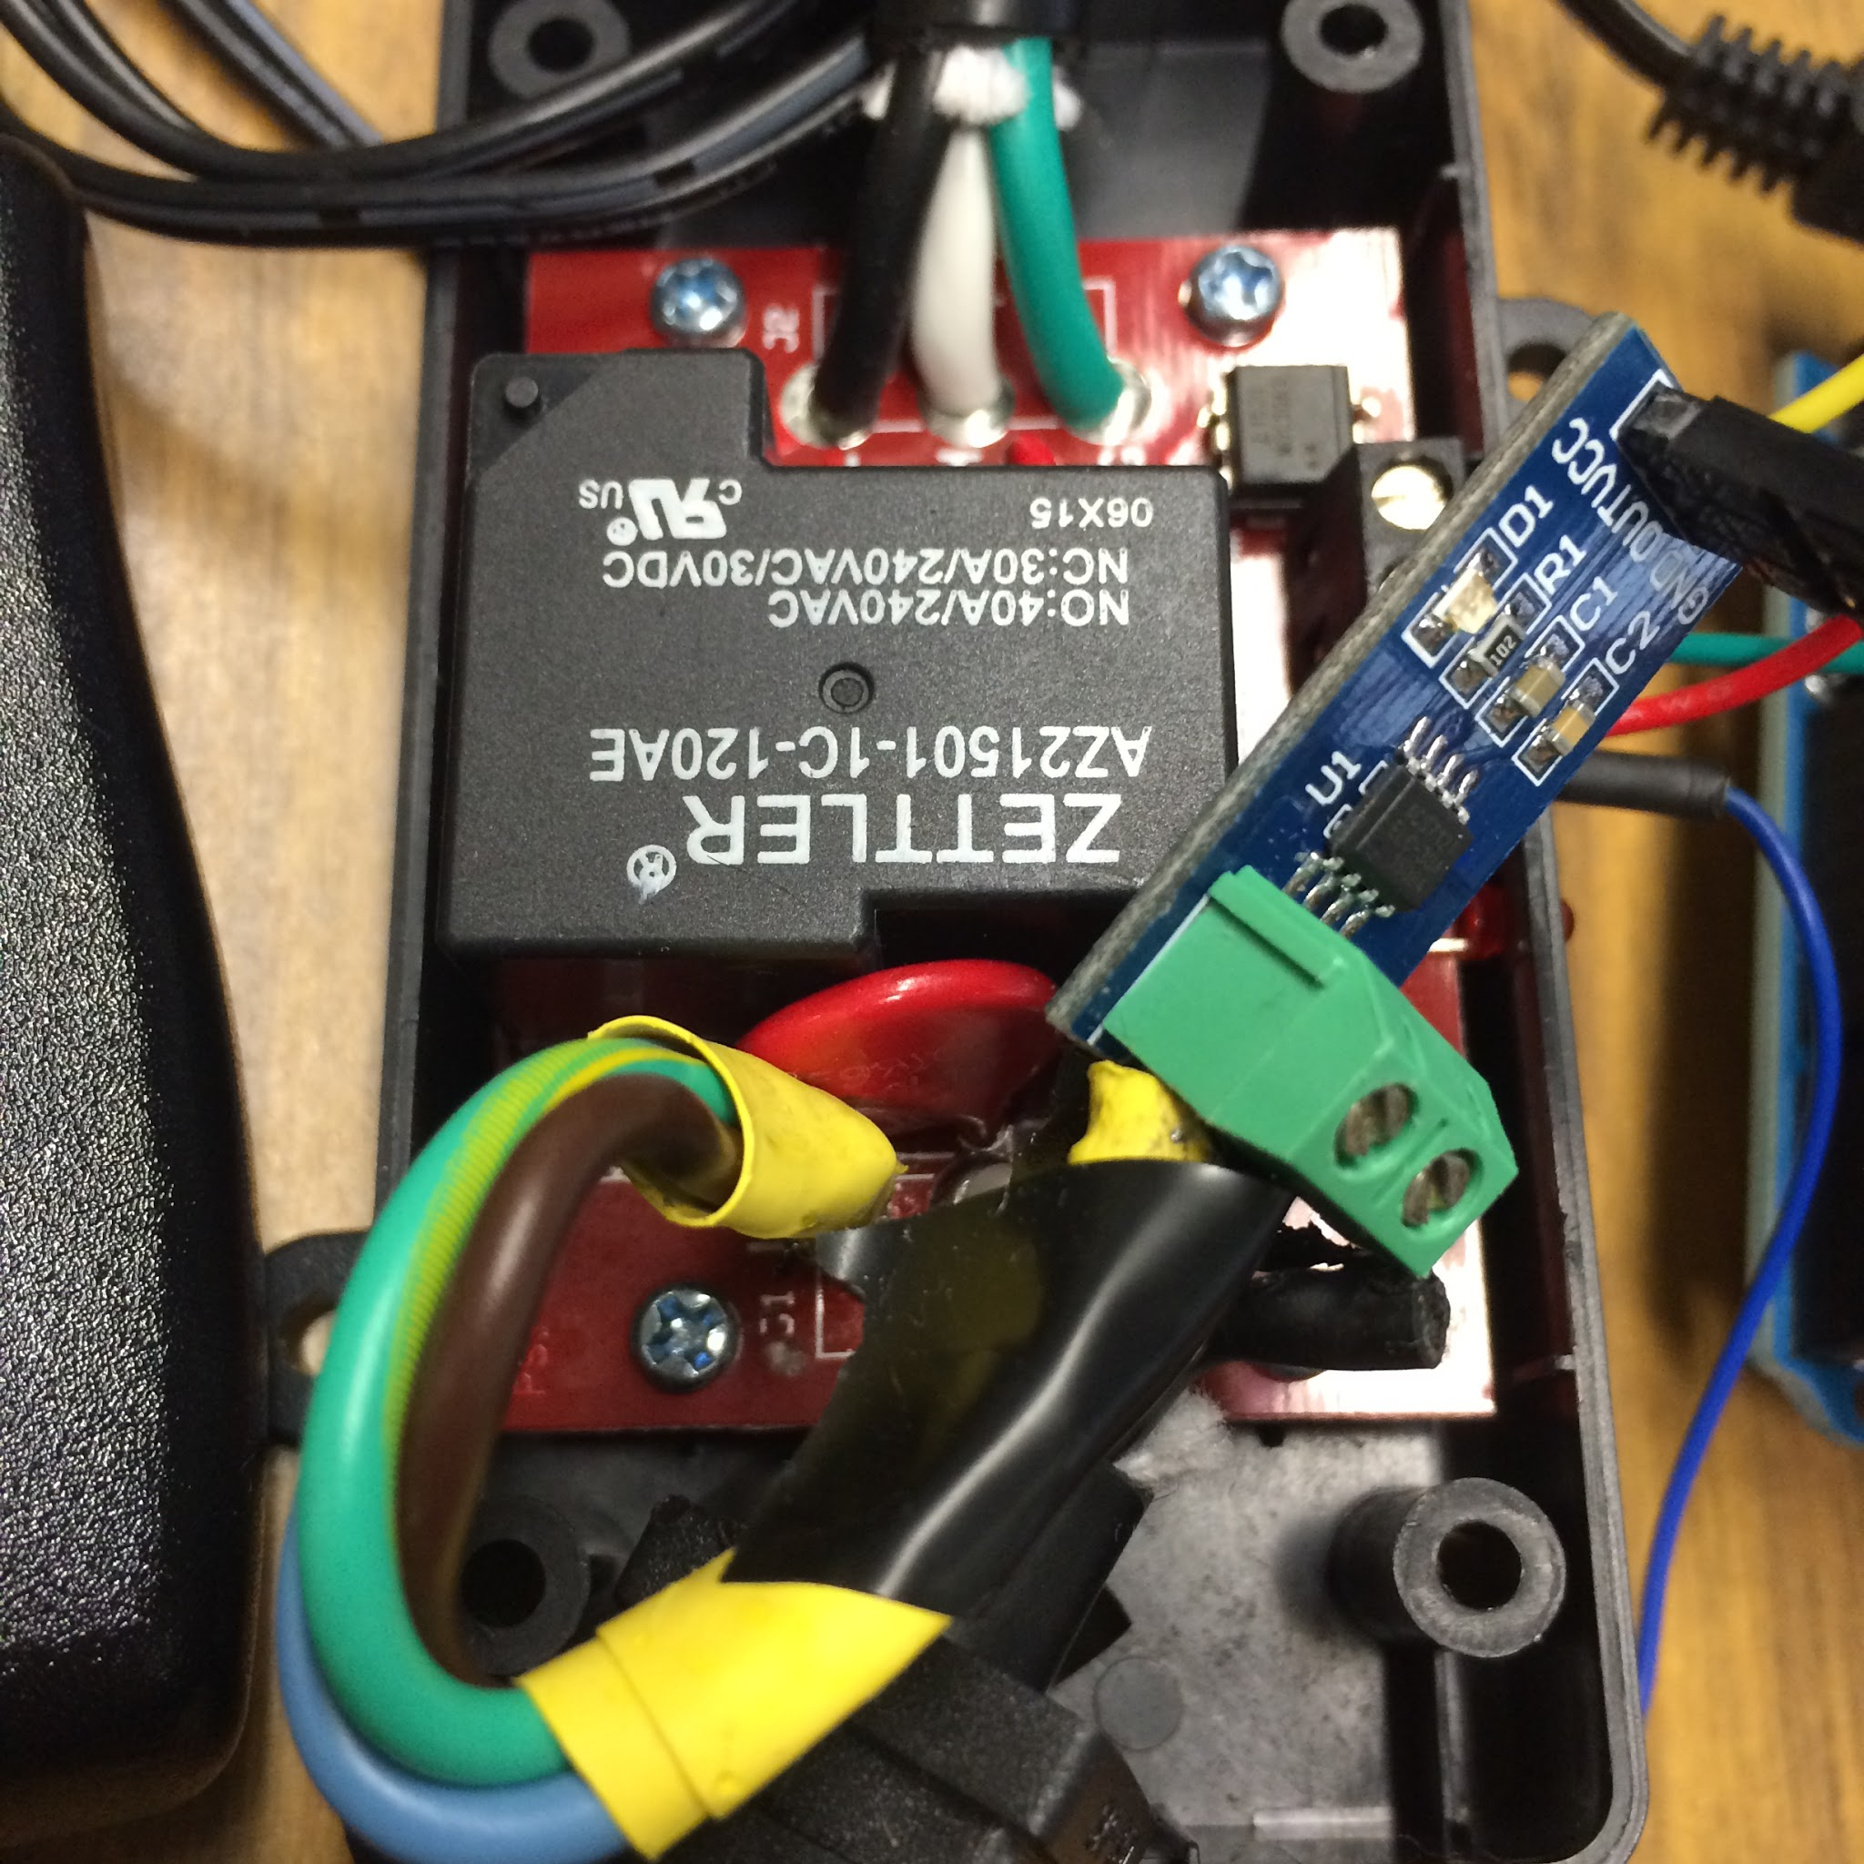
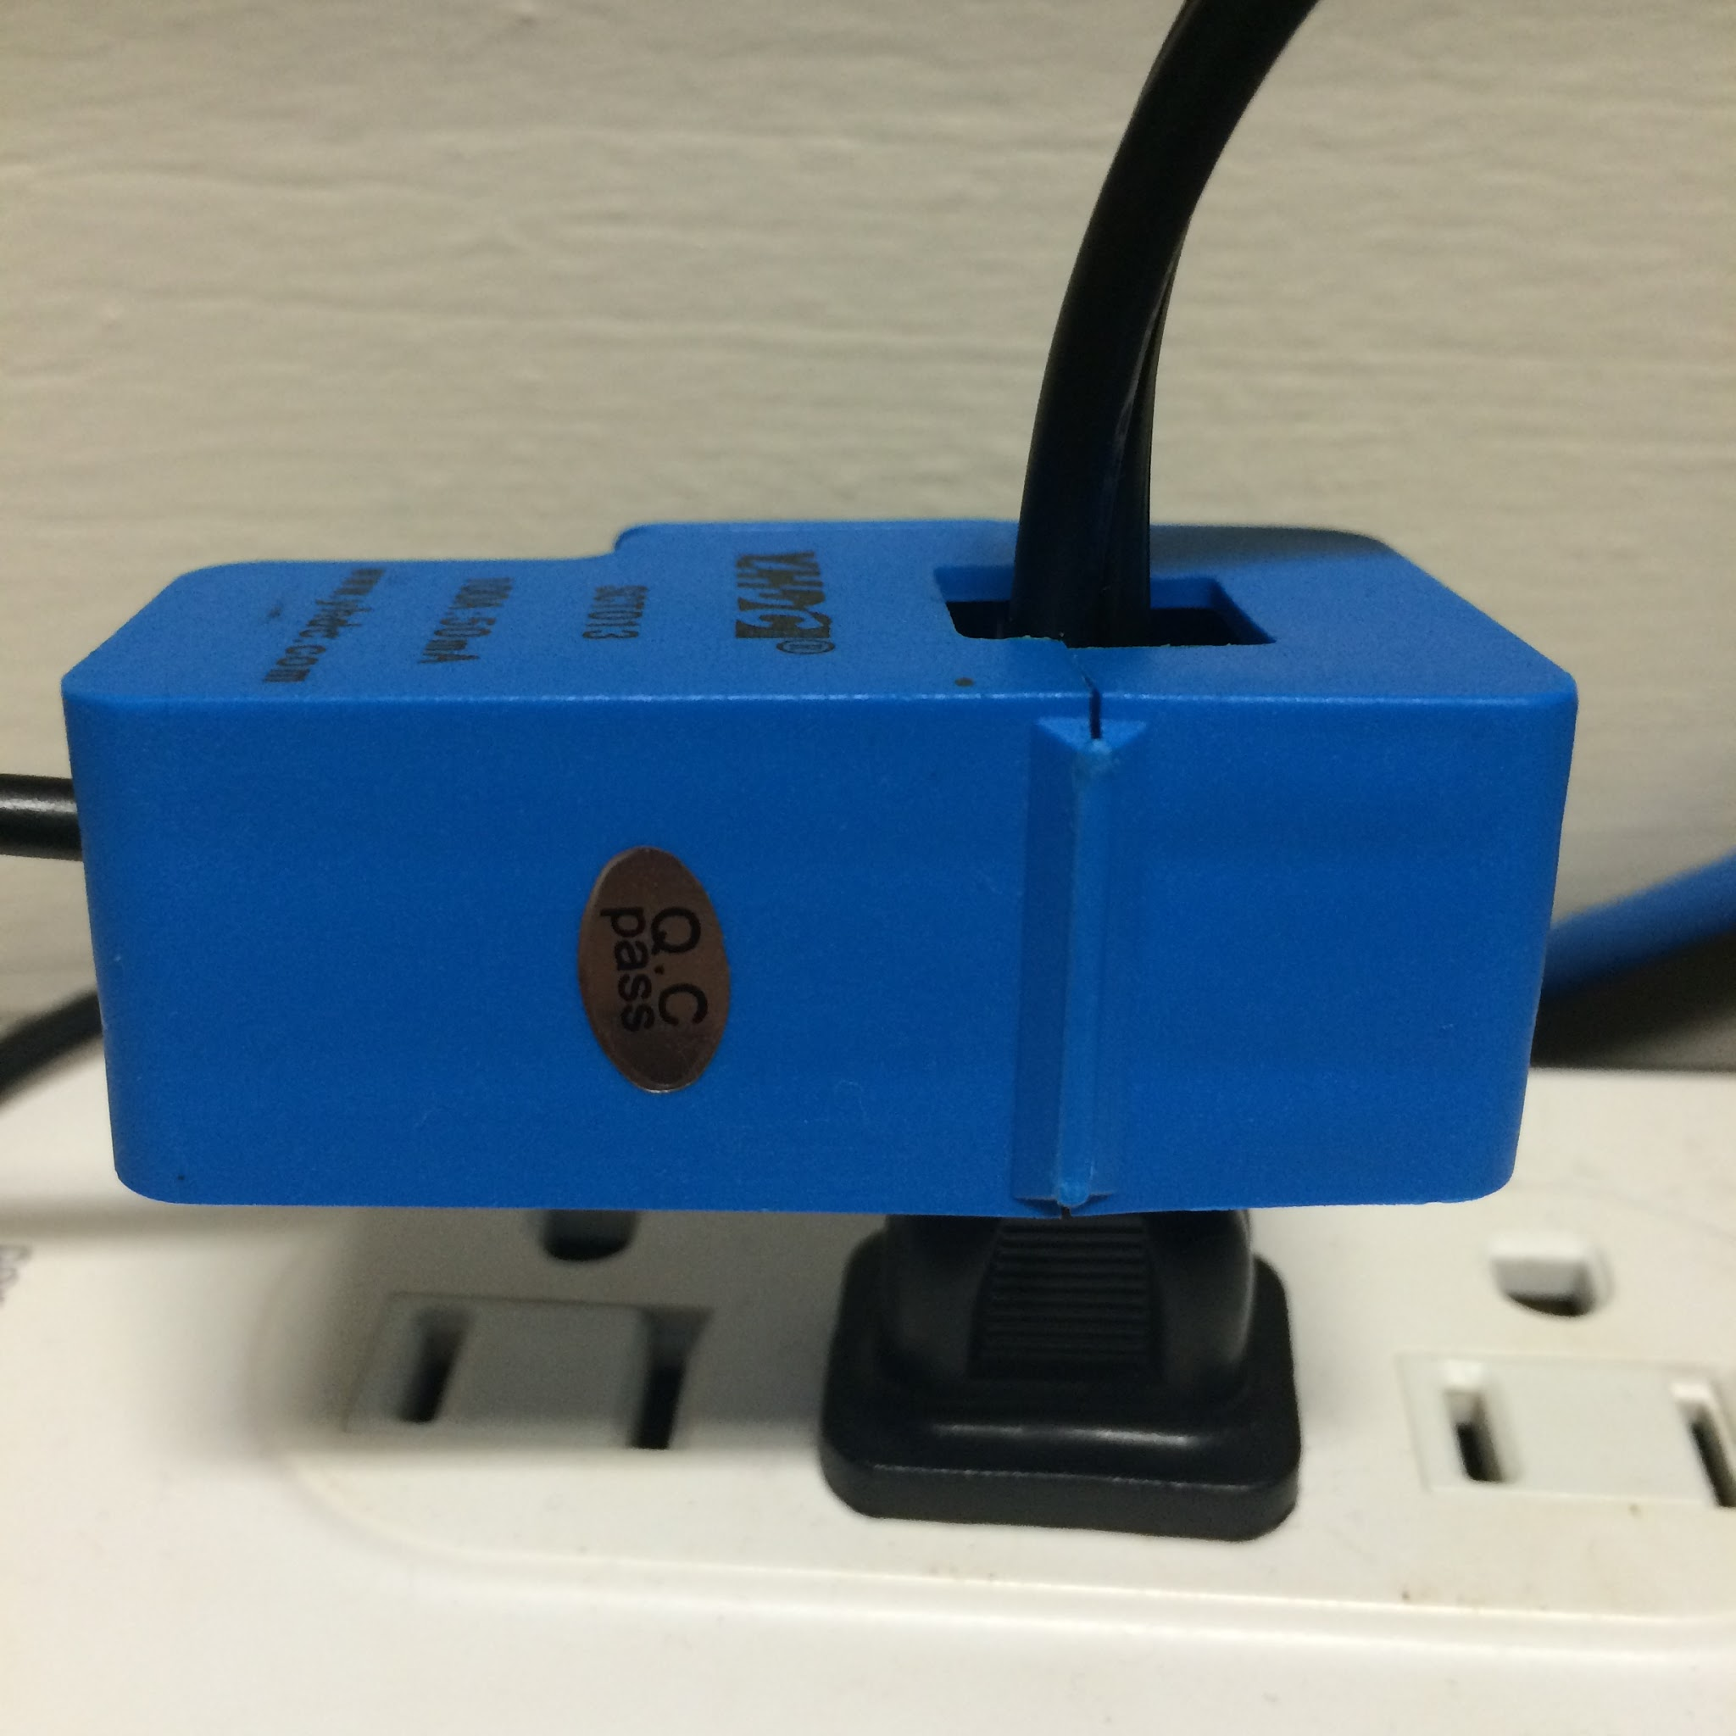
Design Choices
Compactness
In-line current sensor

Slide 6
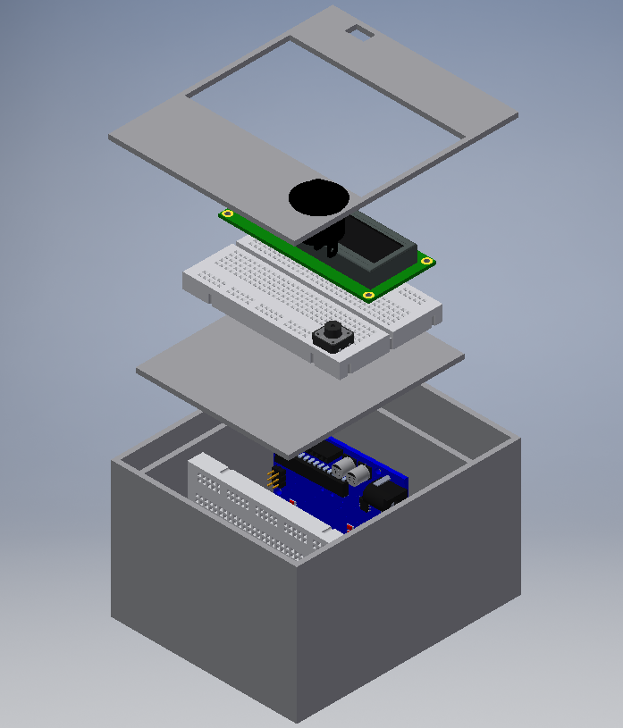
Design Choices
Two breadboards in control module

Slide 7
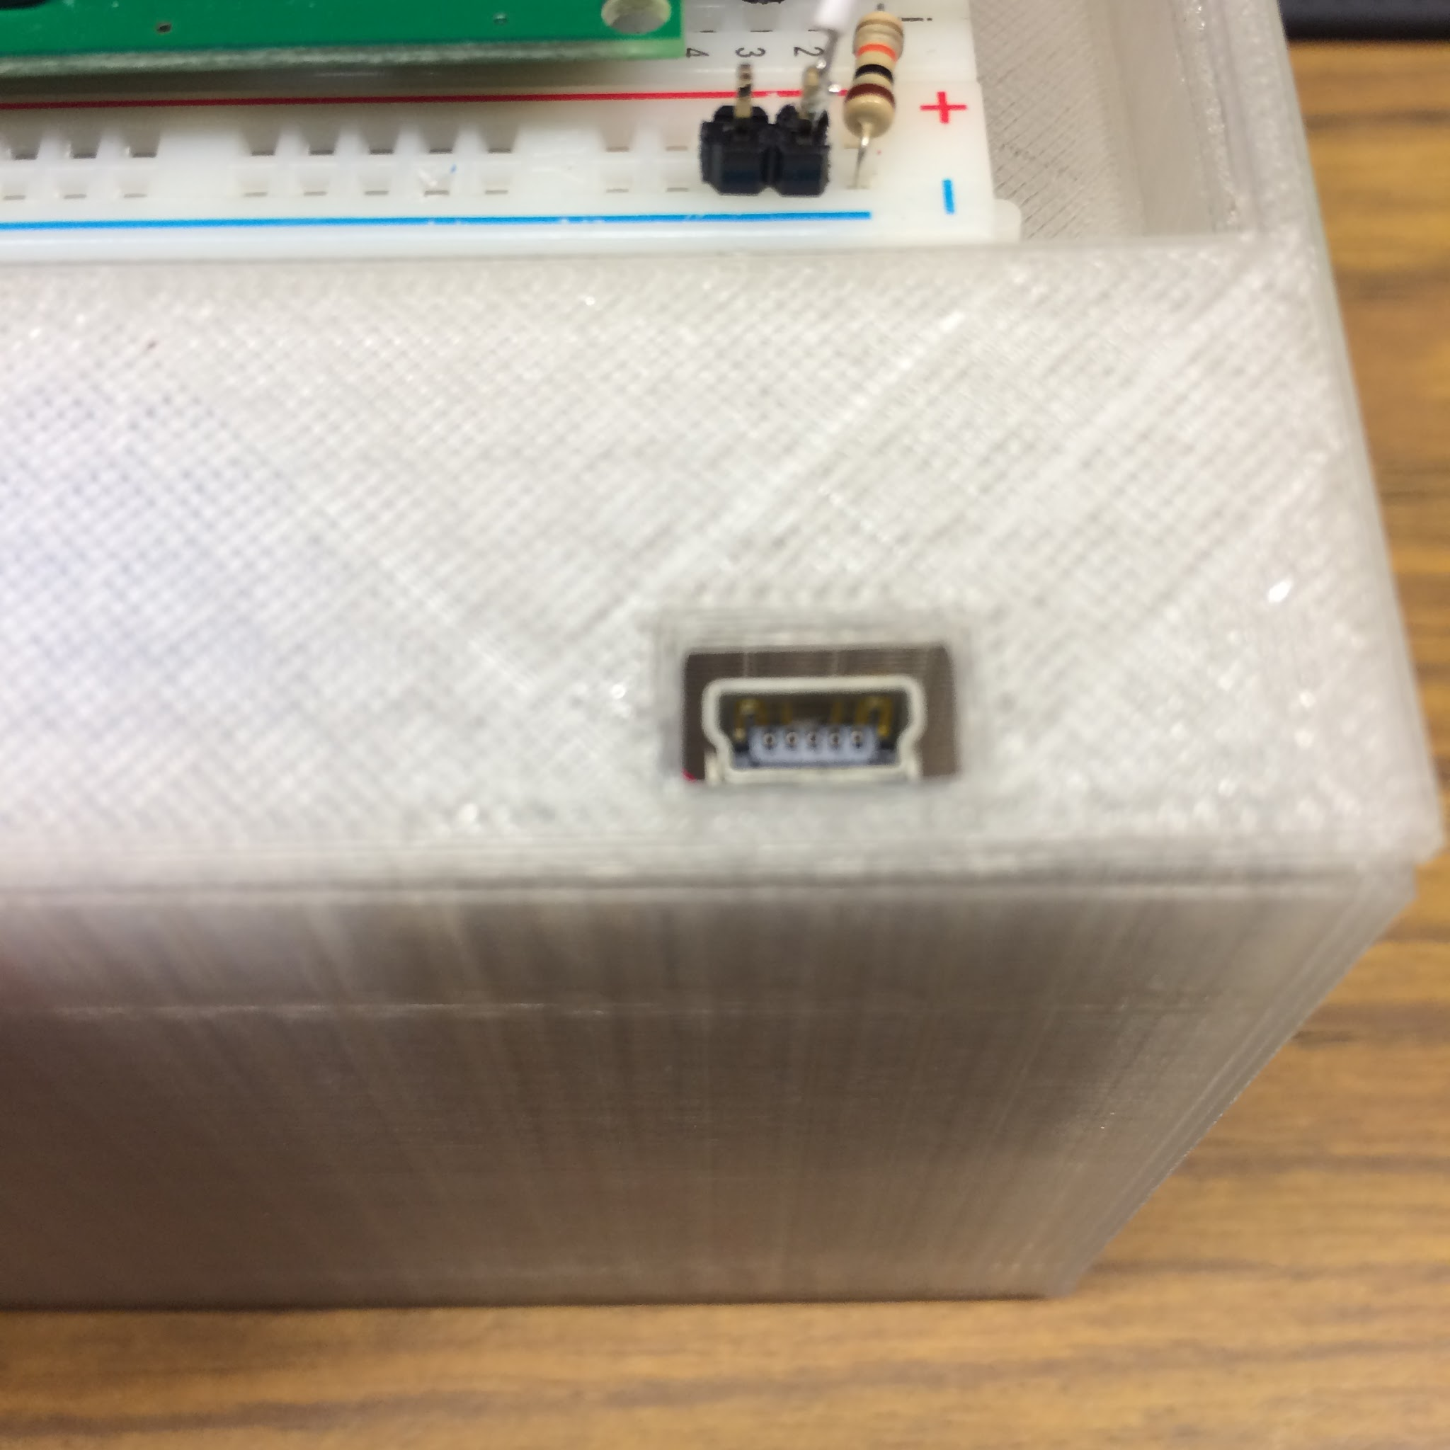
Special Features
Power saving
LCD auto shut down
Charging port

Slide 8
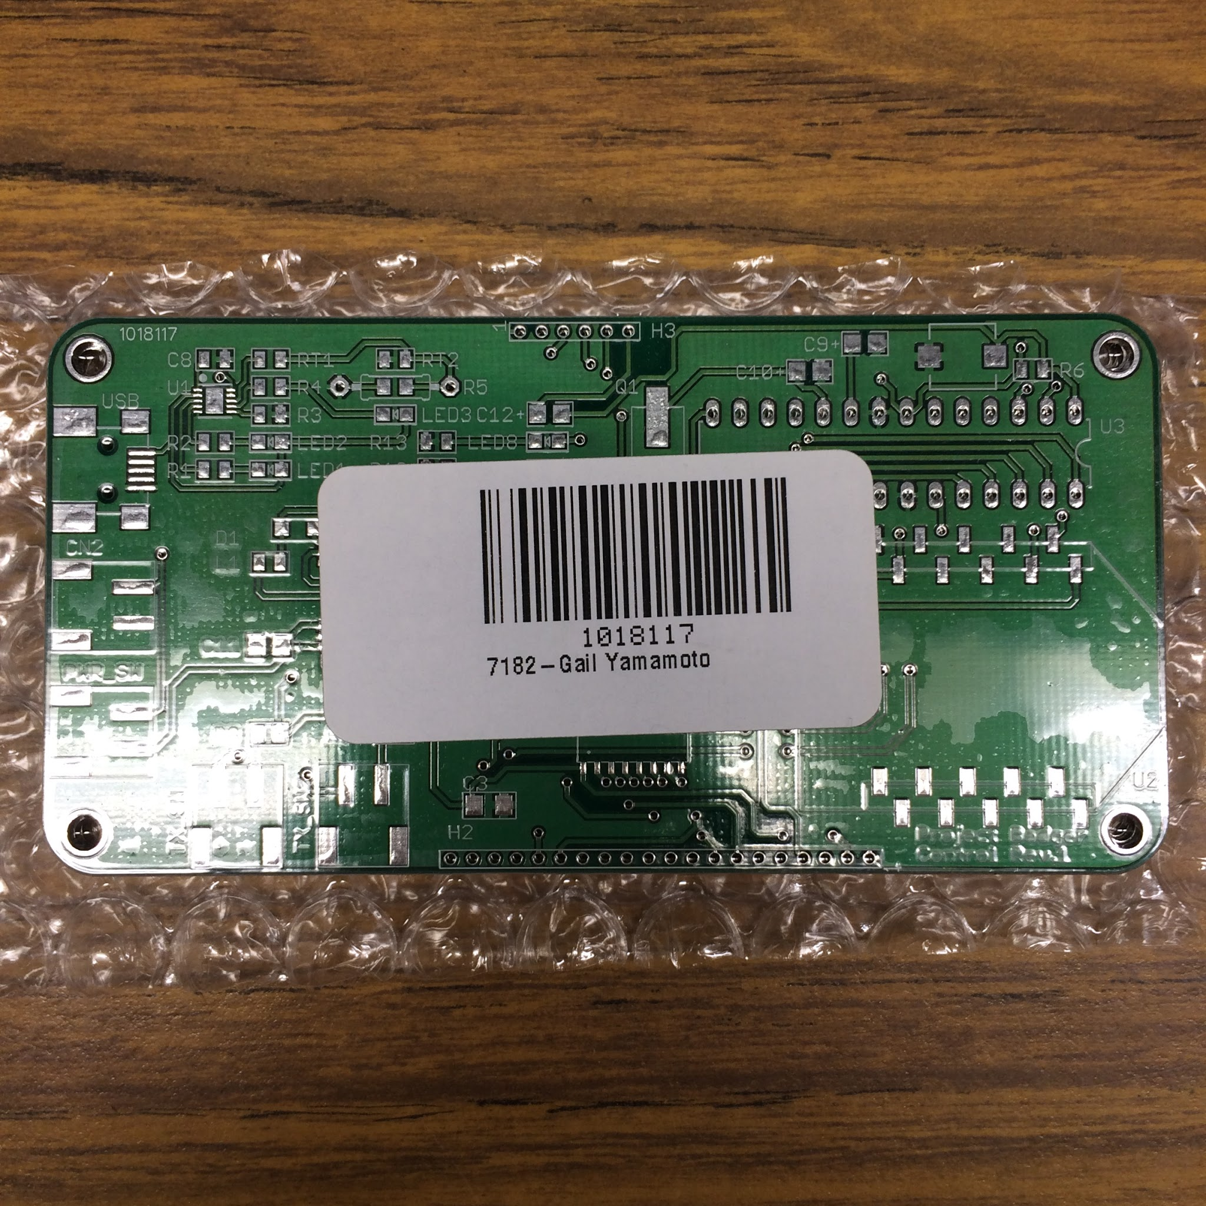
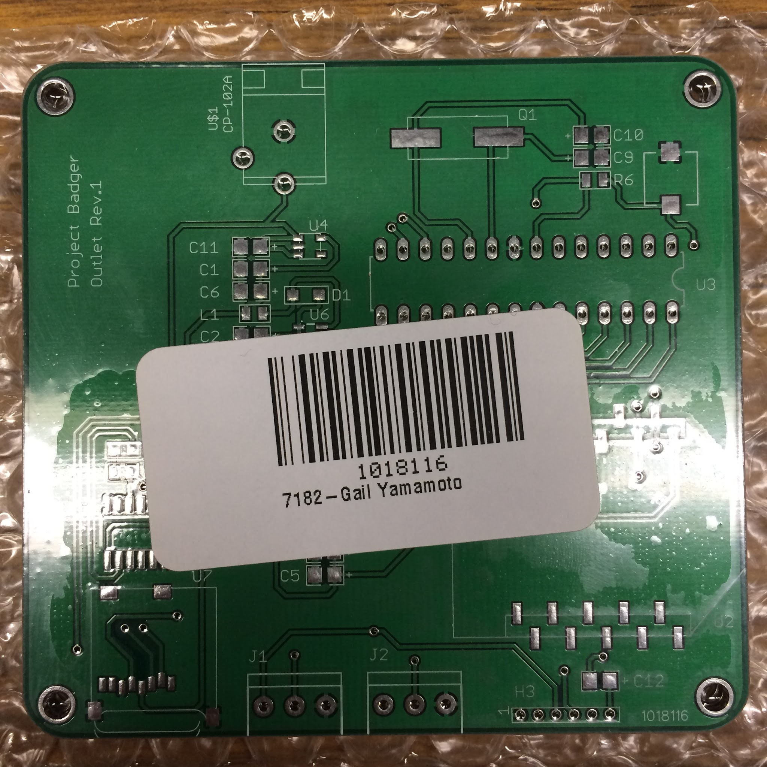
Future Improvements
Use PCB’s to reduce form factor
Control Module > Remote shape
Outlet Module > Outlet mountable

Slide 9
Thank you
Any Questions?

